Slide 1
Nipple and Breast Pain in Nursing Mothers
Anne Eglash MD, IBCLC
Clinical Professor
Dept of Family Medicine
University of WI School of Med and Public Health

Slide 2
Conflict of Interest
None

Slide 3
Objectives
Describe
  3 ways to prevent sore nipples due to inappropriate latch and suck
  3 main pieces of advice to give moms who call with cracked sore nipples
  3 instructions typically given to moms with acute mastitis.
  How to advise moms who might have shingles or herpes on a breast.
  Typical advice given to moms with a plugged duct.
  How to identify and advise care of vasospasm.
  Initial advice in the care of nipple dermatitis.

Slide 4
Sore Nipples and Breasts have nothing to do with:
Having to ‘toughen up’
The baby having a strong suck
Nursing the baby too much or too long

Slide 5
Nipple Pain Starts Early
  11-96% of all women have nipple pain at some point (Blair A. et al Brfeed Review 2003)
  73% of all mothers had mild-mod discomfort by day 3, 27% by day 10. (DeCarvalho et al Birth 1984)
  43% with sore nipples at hospital D/C (Oliveira JHL 22(3) 2006)
  73-76% with sore nipples at 3 days pp, with 19-26% having cracks. (Centuori JHL 15(2) 1999)

Slide 6
Sore Nipples and Breasts
Causes:
1) Improper positioning and latch (#1 cause)
2) Atypical suck
3) Trauma
4) Breast/nipple infections
5) Noninfectious dermatitis of the nipple and areola
6) Poor letdown
7) Pregnancy
8) Vasospasm

Slide 7
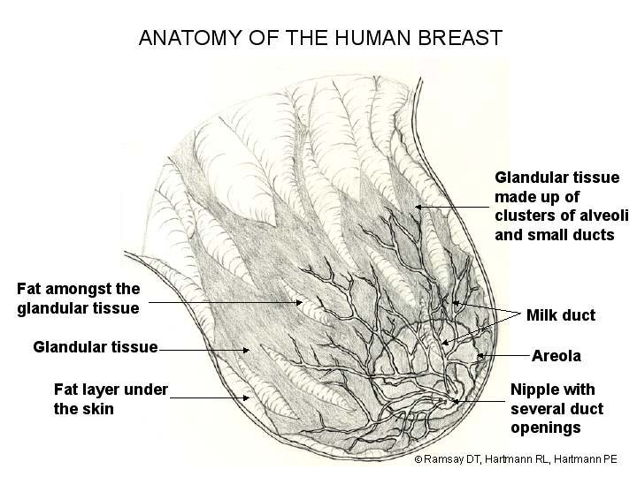

Slide 8
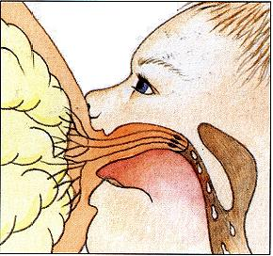

Slide 9
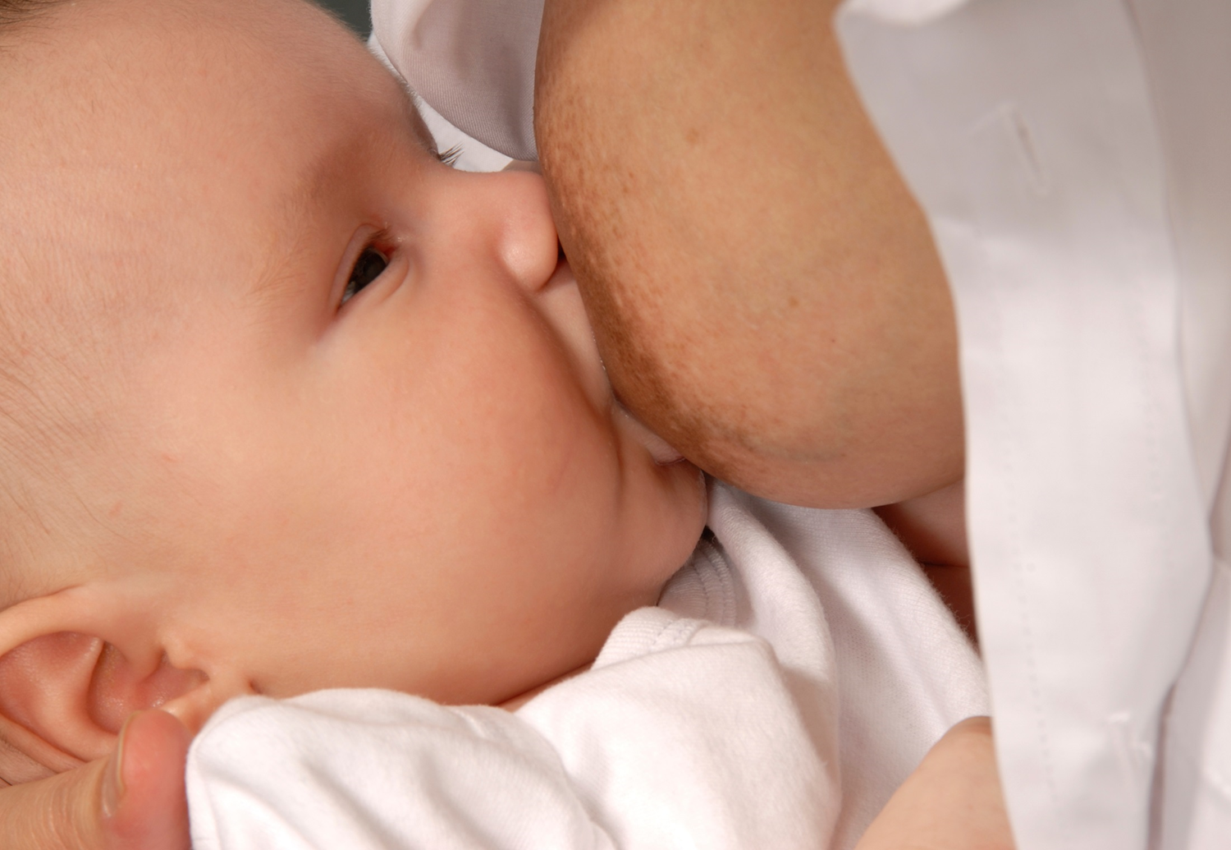

Slide 10
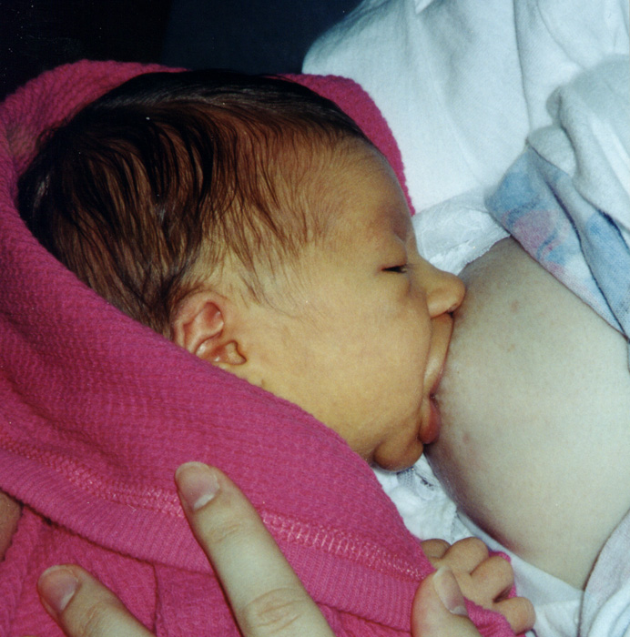

Slide 11
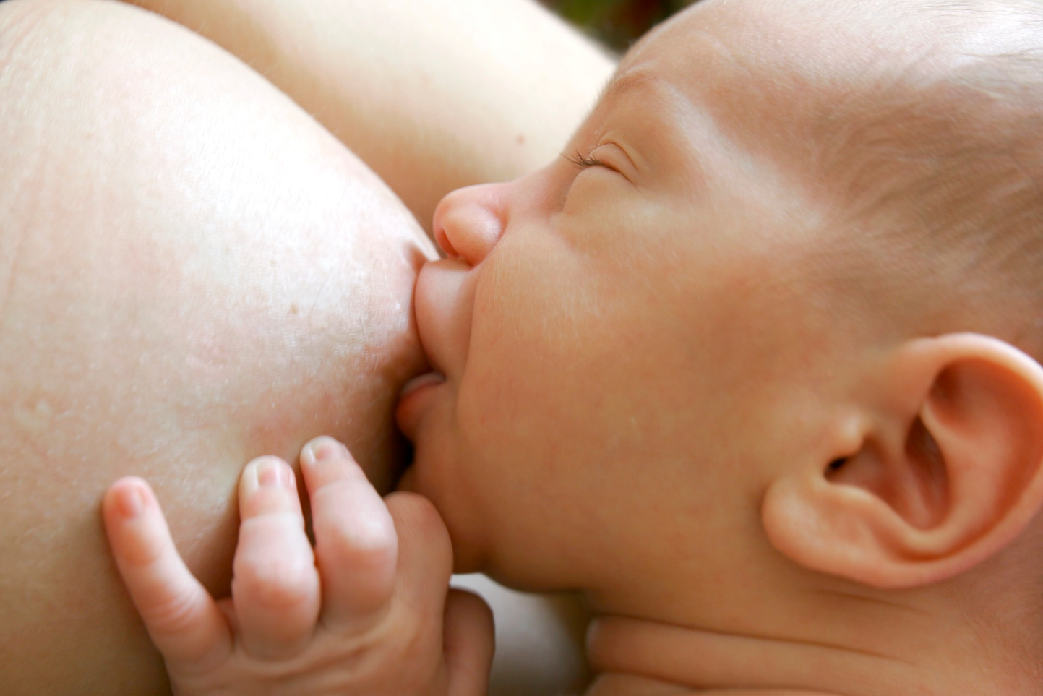

Slide 12
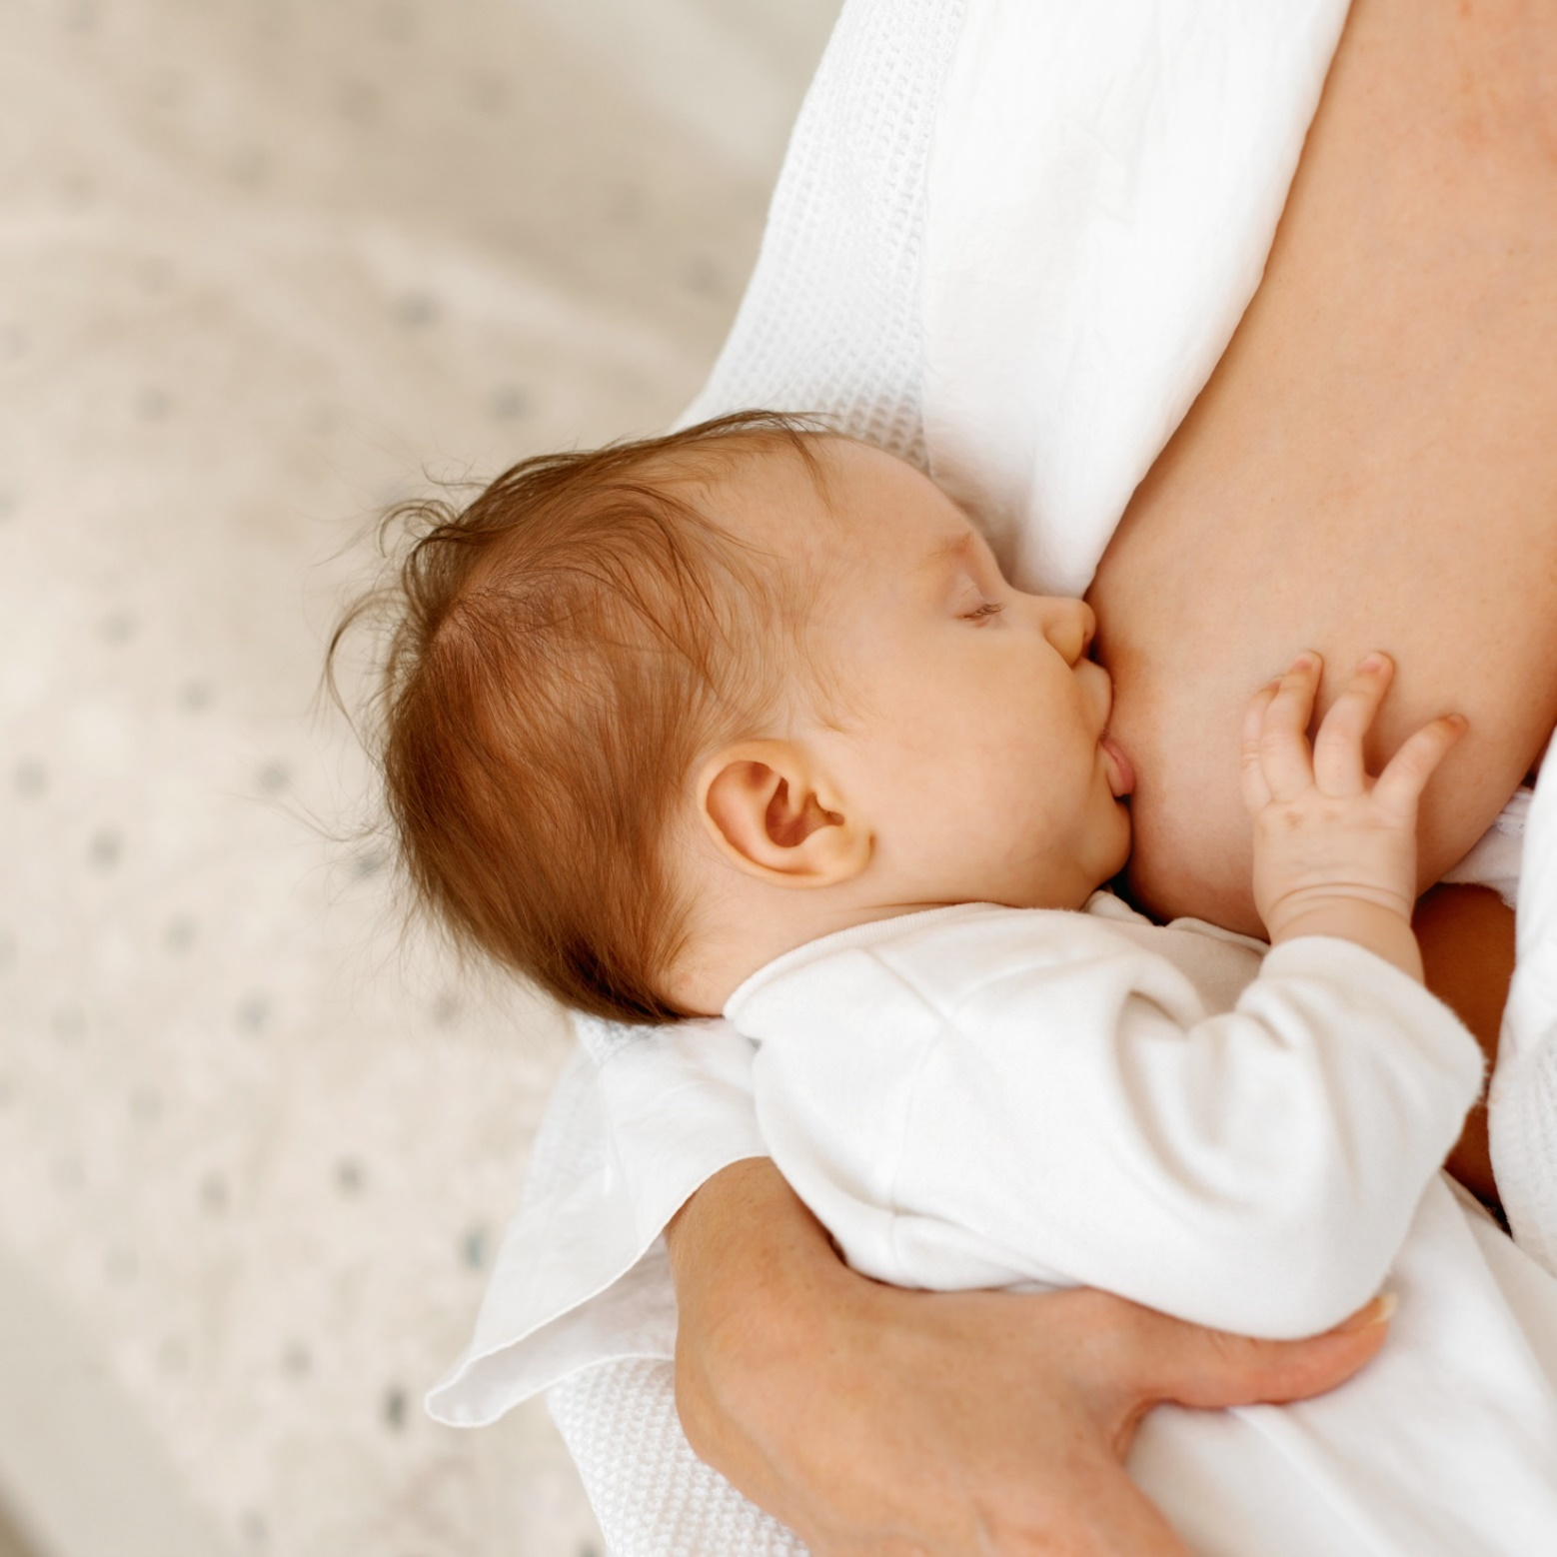

Slide 13
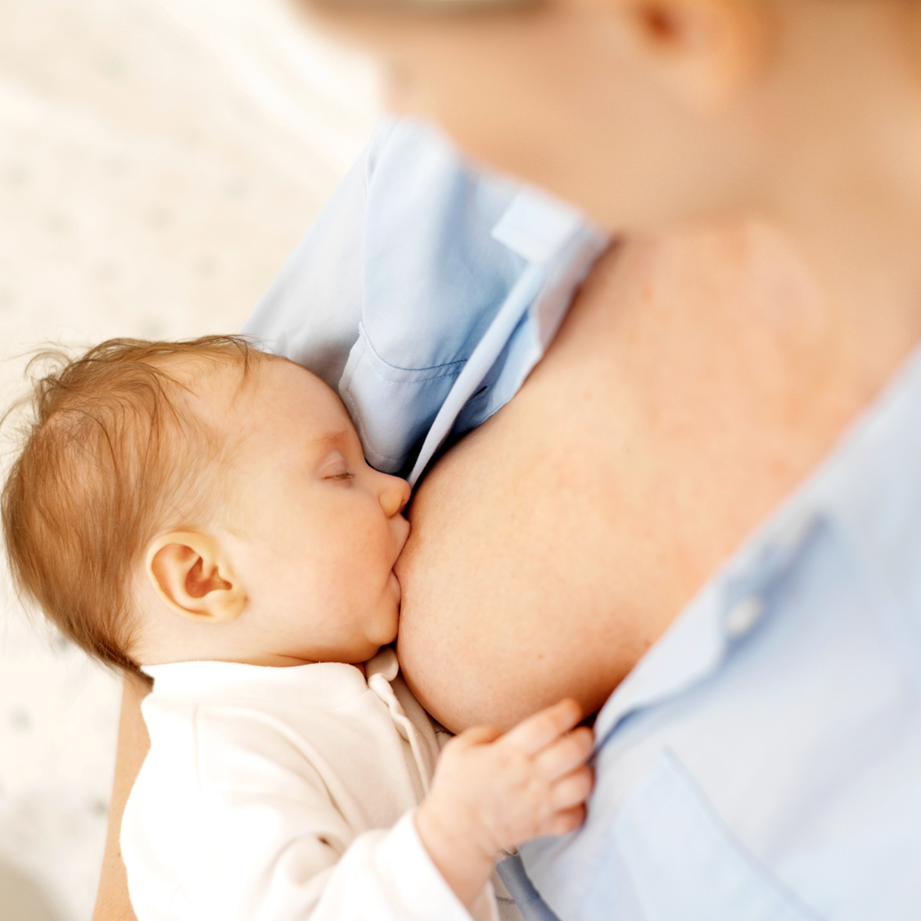

Slide 14
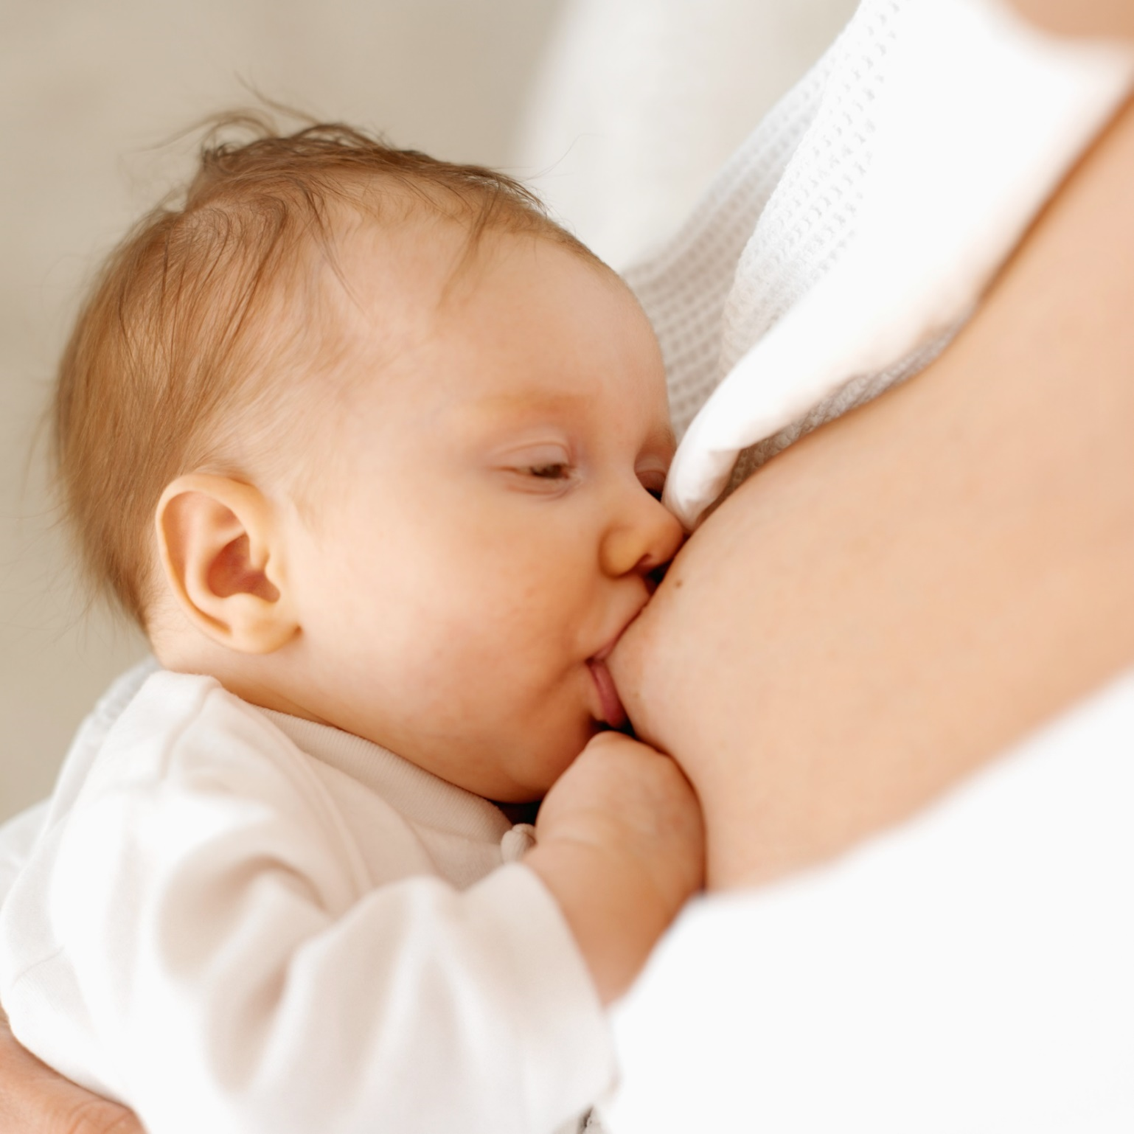

Slide 15
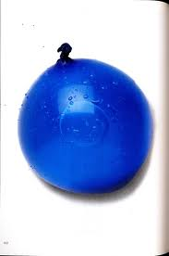
Engorgement
Mainly occurs day 3-5 pp
Increased blood flow and interstitial edema.
May create difficulty with latch-on.
If no nursing or expressing, milk will diminish
Use heat before nursing, cold compresses in between nursing for comfort.
Less of a problem if baby is nursing frequently!

Slide 16
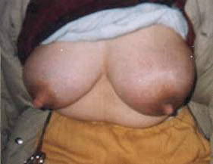

Slide 17
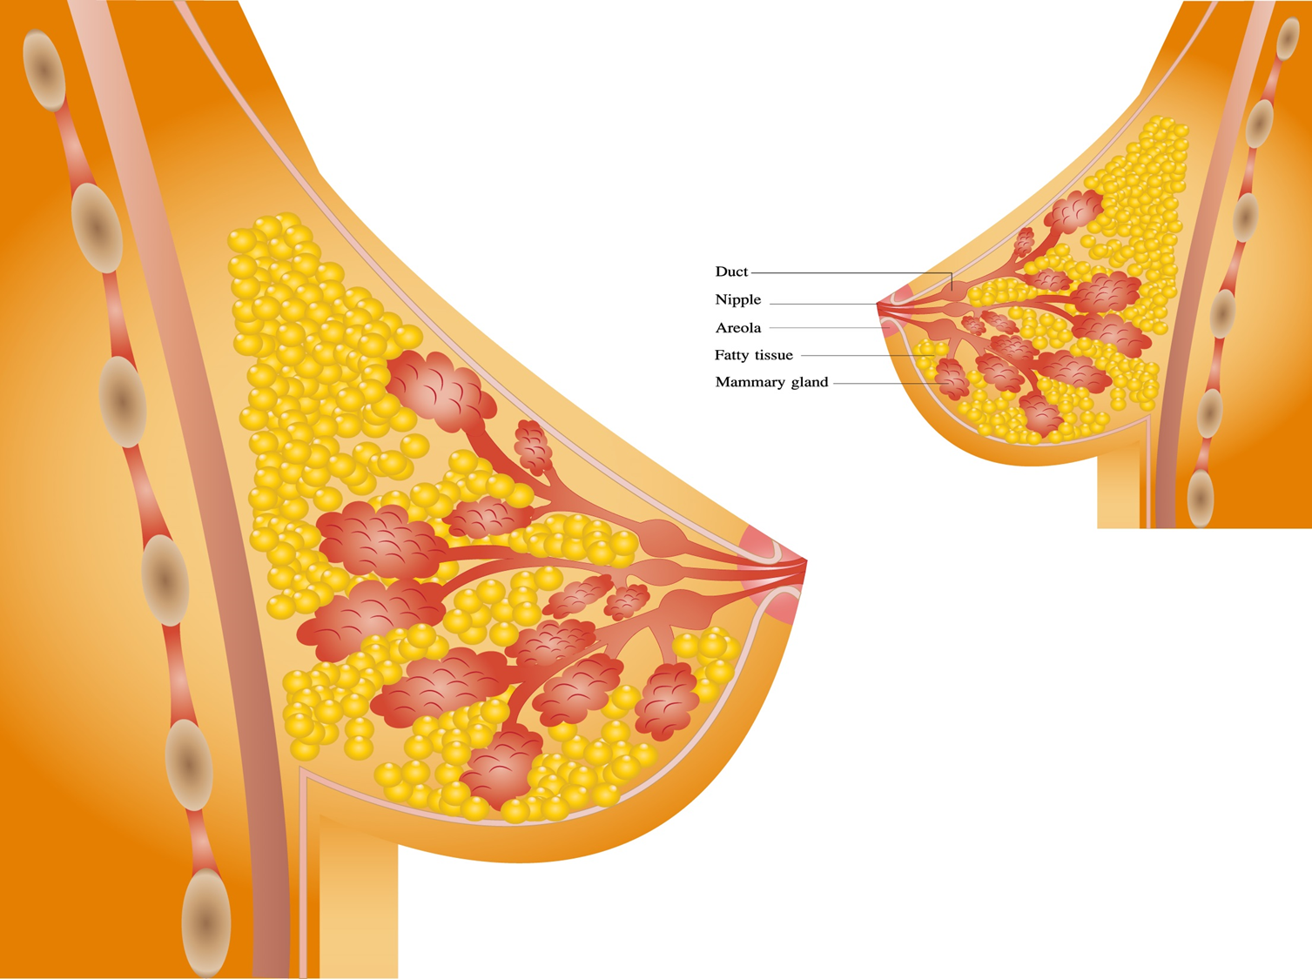
Edema Occurs in the Surrounding
Tissues Outside of the Glands

Slide 18
Engorgement
difficulty latching the baby
sore, cracked nipples
decreased nursing frequency
lower supply
infant fussiness
baby is supplemented
decreased nursing frequency
Mother Quits

Slide 19
Treatment for Engorgement
Use heat before nursing to improve milk flow.
If baby cannot latch, express some milk to soften areolae.
Apply cool compresses after nursing to decrease edema.
Best Treatment is prevention with frequent nursing!!

Slide 20
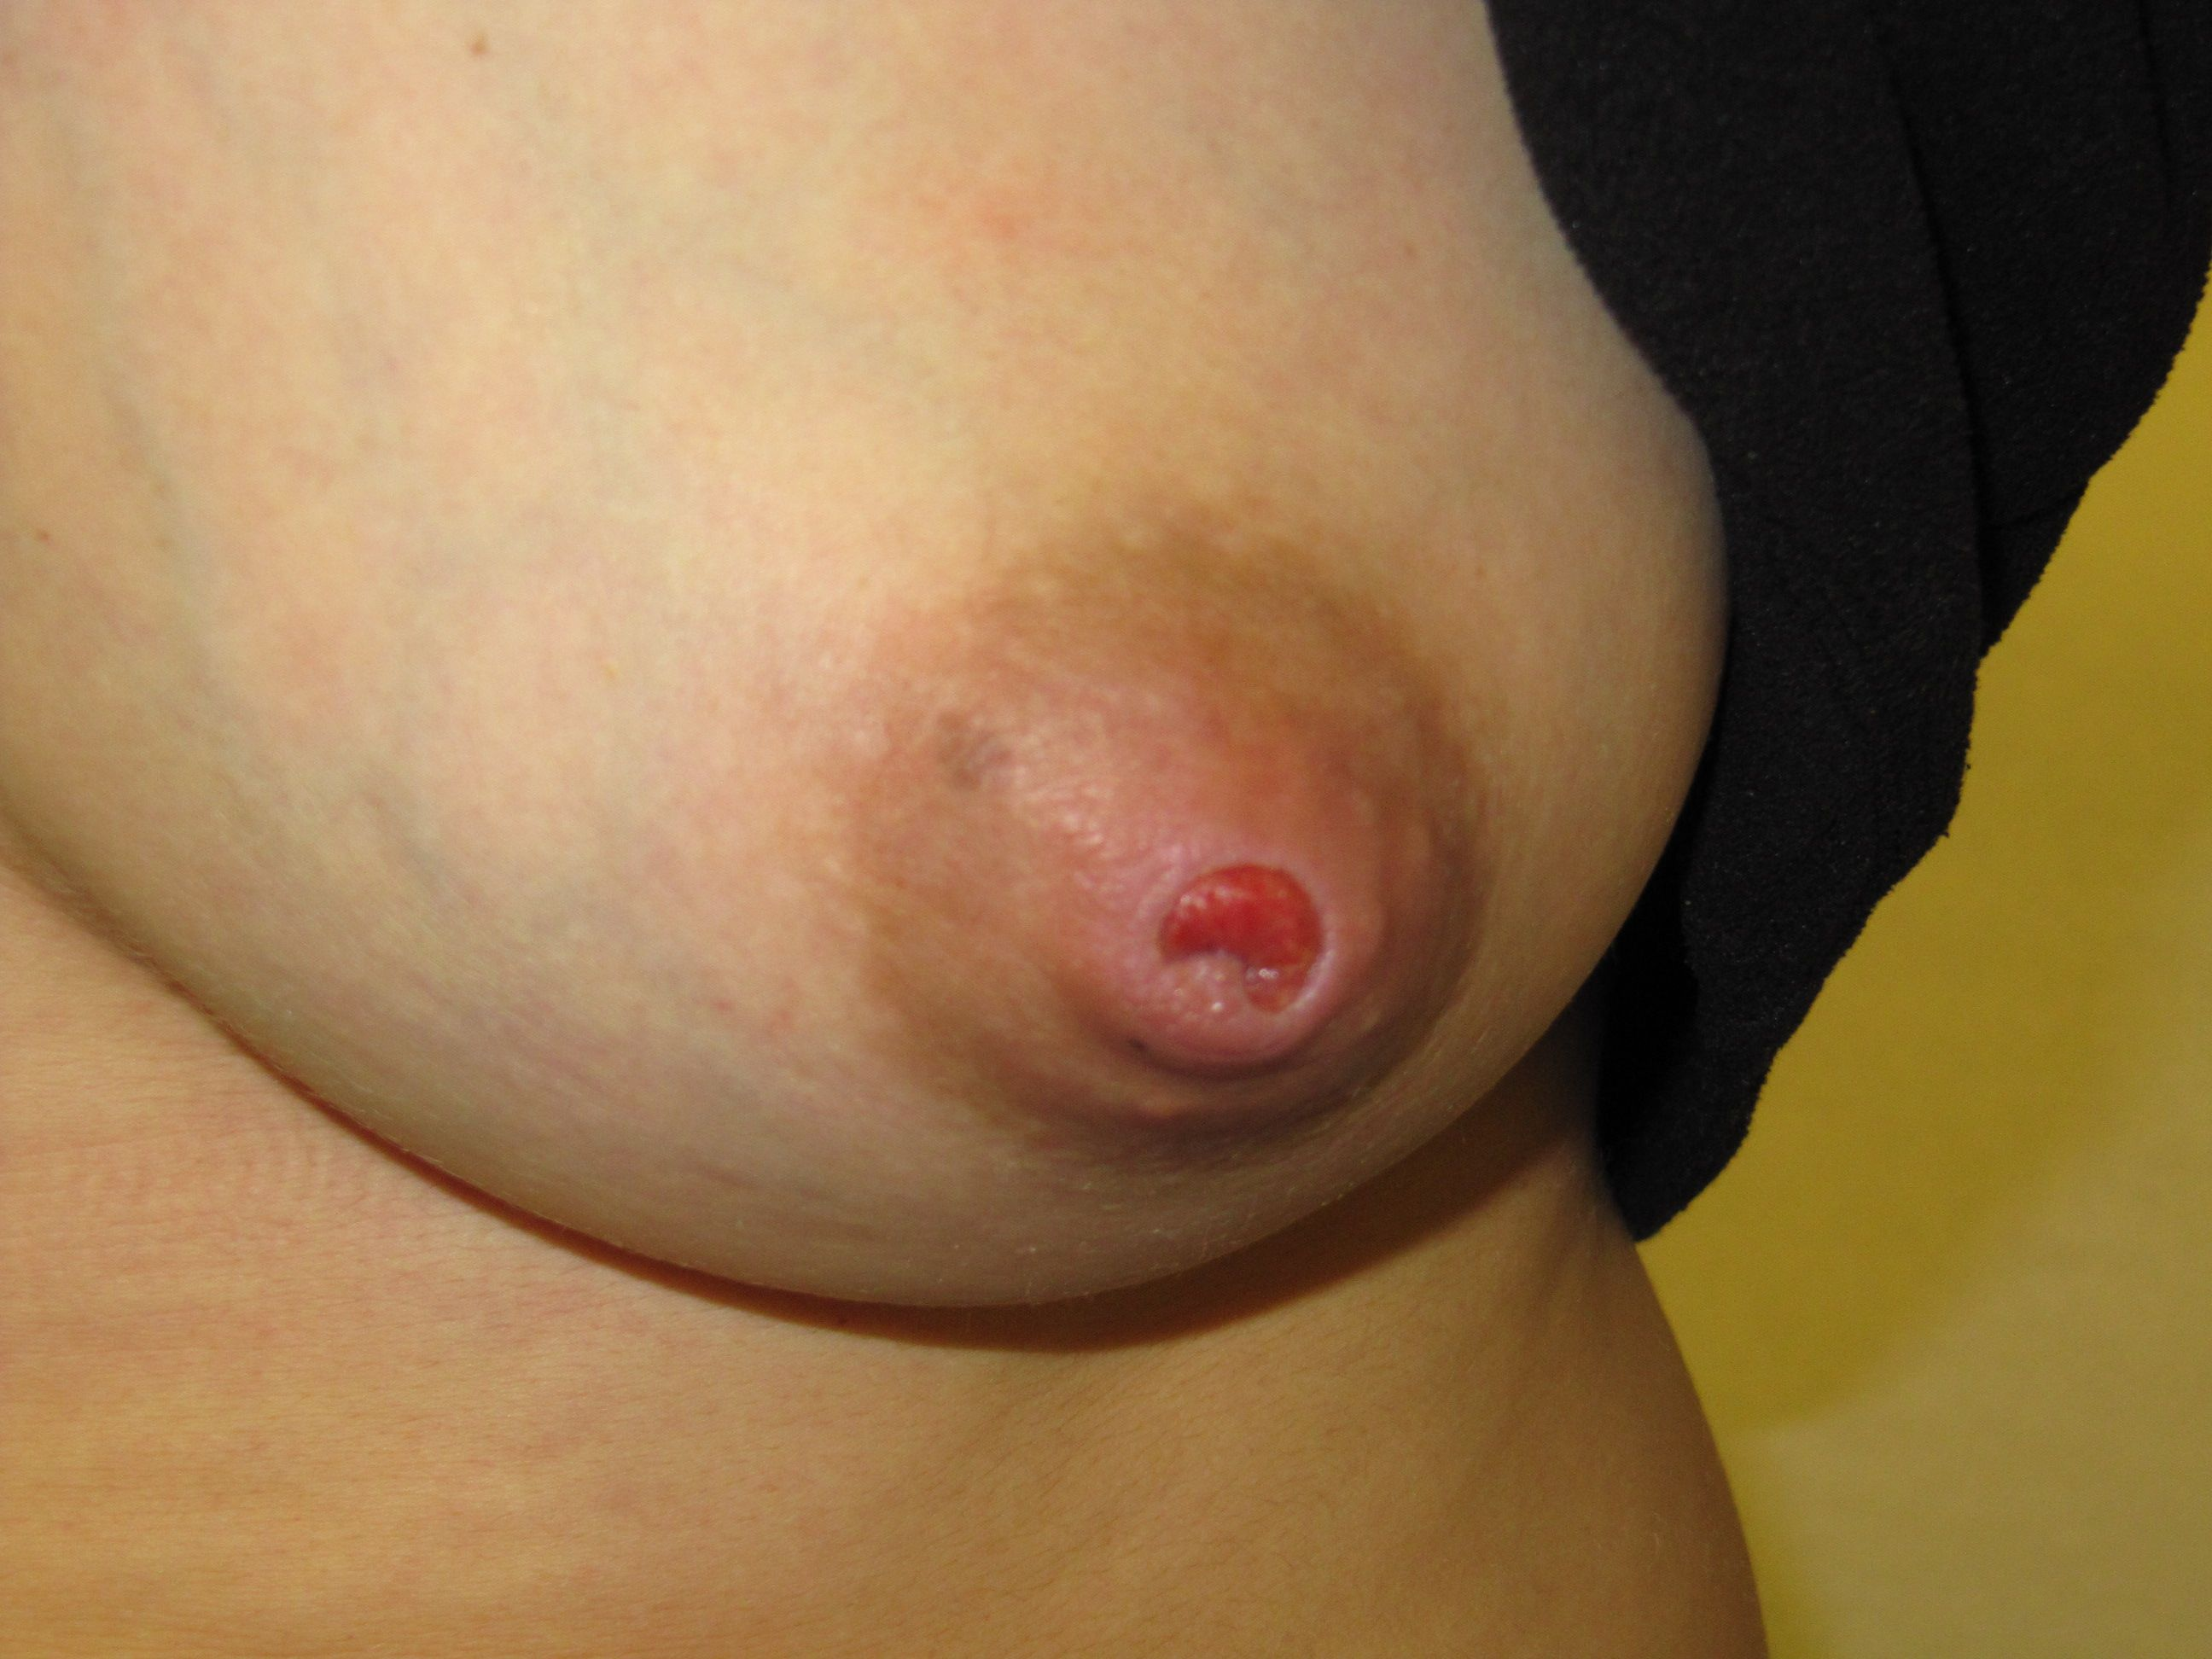

Slide 21
Cracked Nipple Treatment
Moist Wound healing
  Don’t let nipple stick!
    Bacitracin
    Mupirocin
Decrease trauma- improve latch!!
Treat underlying skin pathology
  ? Dermatitis/psoriasis
Treat deep breast infection
Assess for deep breast pain

Slide 22
Management of Nipple Trauma
Underlying problems
  Torticollis/clavicle fx/infant facial trauma
  Prematurity/low tone/sleepiness
  Flat broad nipples
  Engorgement
  Maternal limitations with positioning
  Overactive letdown/slow flow
  Nutritive vs nonnutritive suck
  Oral defensiveness, tight lingual frenulum, oromotor dysfunction
  ETC…
Strategies
  Change positions, treat pain
  Supplement with SNS, or PC with bottle, limit time at breast
  Pump before nursing
  Aid in positioning
  Nipple shield to manage flow, change in positioning
  Train with bottle or finger feeding
  Clip lingual frenulum
  Speech therapy eval

Slide 23
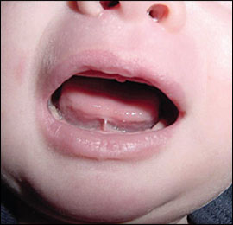

Slide 24
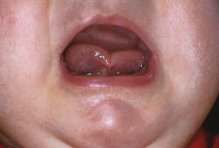

Slide 25
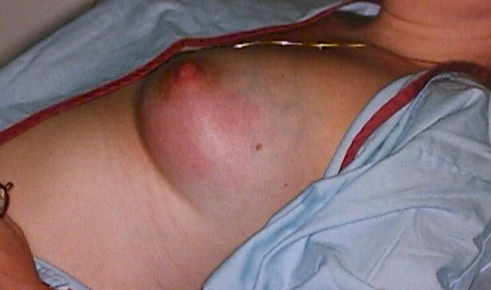
Acute Mastitis

Slide 26
Acute Mastitis Symptoms
‘Flu’- with myalgias, headache, fever, nausea
Early on minimal breast pain and redness, which progresses over time.
Breast becomes swollen, indurated, red, and very tender
Nipples may have open areas

Slide 27
Acute Mastitis-Risk Factors
NEJM April 2, 2003 p.1609-1612
Less than 3 months postpartum
Primiparity
Stress
Incomplete emptying
Abundant milk supply
History of mastitis with previous children
Nasal carriage of Staph Aureus

Slide 28
Acute Mastitis
NEJM April 2, 2003 p.1609-1612
8-19% of women have recurrent episodes of mastitis
5-10% of women with mastitis may go onto abscess formation
3% of moms with mastitis go to on abscess (Amir, Australia)

Slide 29
Mastitis Treatment
Collect a breastmilk culture
  R/O MRSA
Rest
Moist heat frequently
Drain breasts well
Hydrate
Antibiotics that are anti-staph are necessary-high dose diclox, clinda, cephalex, augmentin
Anti-inflammatories to decrease pain
  ibuprofen is best
Probiotic with lactobacillus salivarius

Slide 30

Abscesses during Lactation
Require drainage or I&D
Continue antibiotics, rely on culture results
Keep breast well-drained
Baby may nurse if milk is not purulent

Slide 31
Sore Nipples and Breasts
Causes:
1) Improper positioning and latch (#1 cause)
2) Atypical suck
3) Trauma
4) Breast/nipple infections
5) Noninfectious dermatitis of the nipple and areola
6) Poor letdown
7) Pregnancy
8) Vasospasm

Slide 32
Dermatitis
Latch and Suck
Trauma
Infection
Vasospasm
You are here

Slide 33
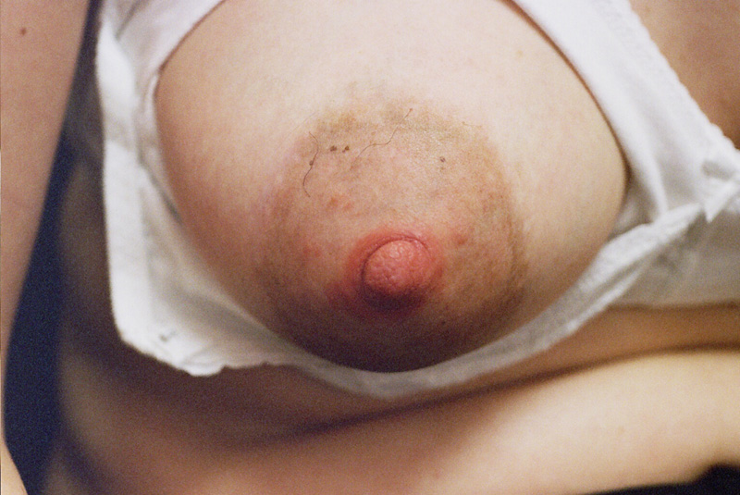
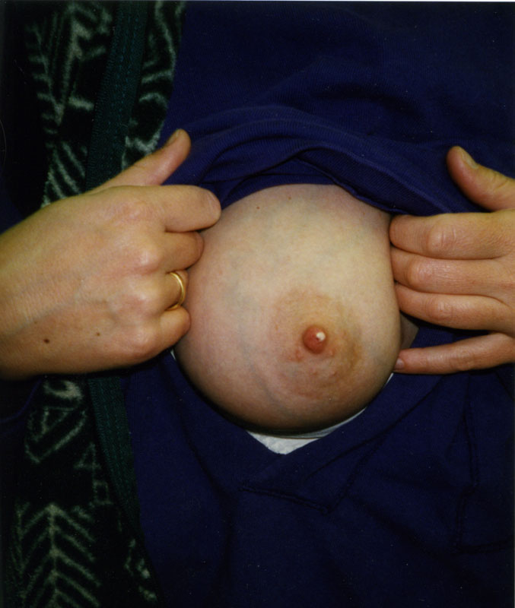
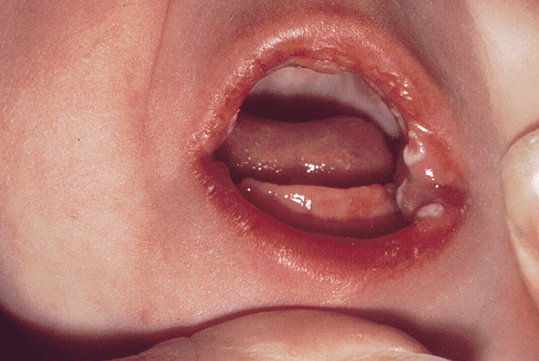
Breast Pain- Yeast or Bacterial?

Slide 34
Typical Clinical Scenario about Yeast
Mom calls, her 10 week old was recently diagnosed with thrush. She is noticing a burning/itchy sensation to her nipples, and would like to have something for the yeast infection of her nipples.

Slide 35
‘Yeast’ Infections of the Nipple and Breast
Typical sx
  Burning, itching, ‘shards of glass’, sharp shooting pain, redness of nipples
Classic risks
  Infant oral thrush, mat antibiotics, DM, steroids
Too often empirically treated by phone
Very little evidence available

Slide 36
When to treat for Yeast
Nipples should look red, possibly white discharge
  Nipples also hurt
Infant has known oral thrush
If nipples don’t look red, refer for evaluation before assuming thrush

Slide 37
Treatment for Maternal Thrush
Topical nystatin ointment or clotrimazole ointment for mild sx
  No need to take off before nursing.
Fluconazole 200mg daily for mod sx

Slide 40
Infant Treatment of Thrush
Oral nystatin- 1-2 ml each cheek qid
Oral fluconazole 6mg/kg load, then 3mg/kg once a day for 7-14 days
Gentian Violet- 1 treatment every 3 days

Slide 41
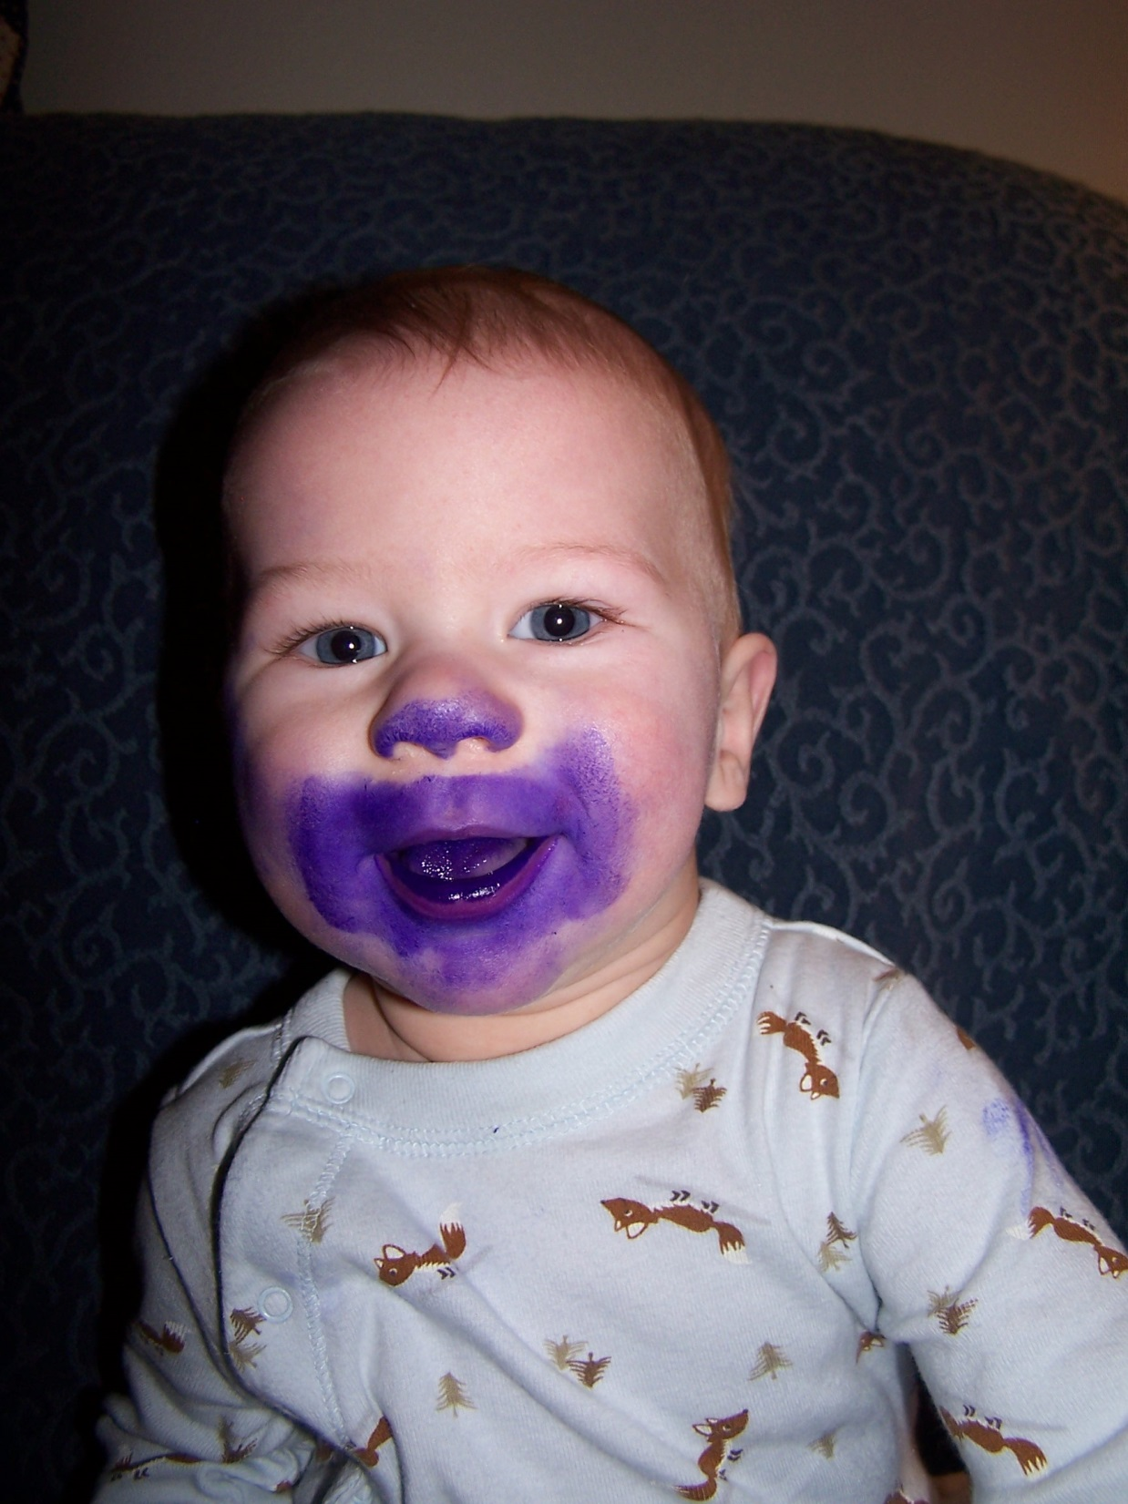
Gentian Violet
Used fairly often at 0.5-1% solution every 3 days until thrush gone
Can cause oral ulcerations if used more often

Slide 42
Sx of Subacute Mastitis or Bacterial Lactiferous Duct Infection
Nipples are tender and latch hurts
Deep breast pain after feeding
  Often considered ‘yeast’
Breasts feel tender
Intermittent sharp shooting pains in the nipples and breasts
Recurrent plugged ducts
Nipples look fine or have yellowish scabs at the tips.

Slide 43
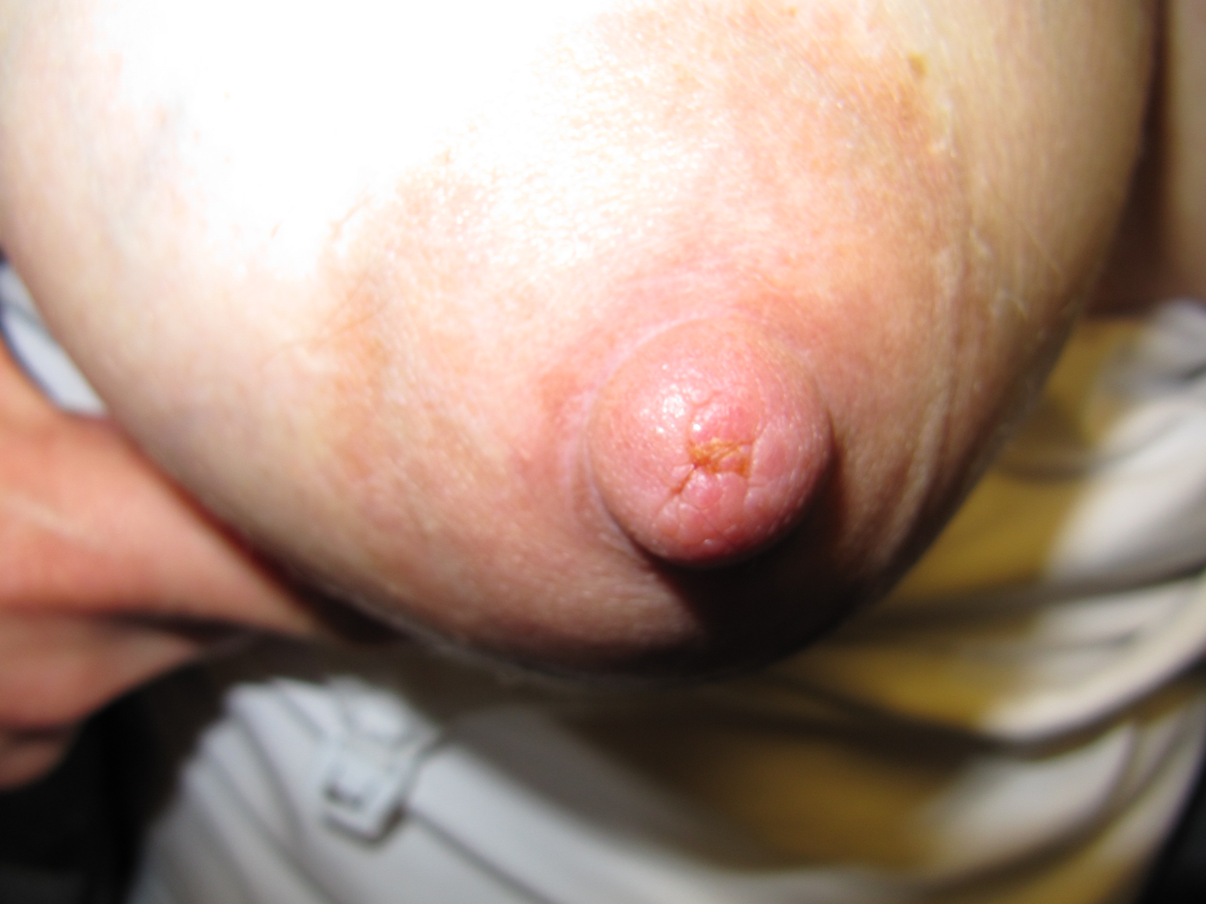

Slide 44
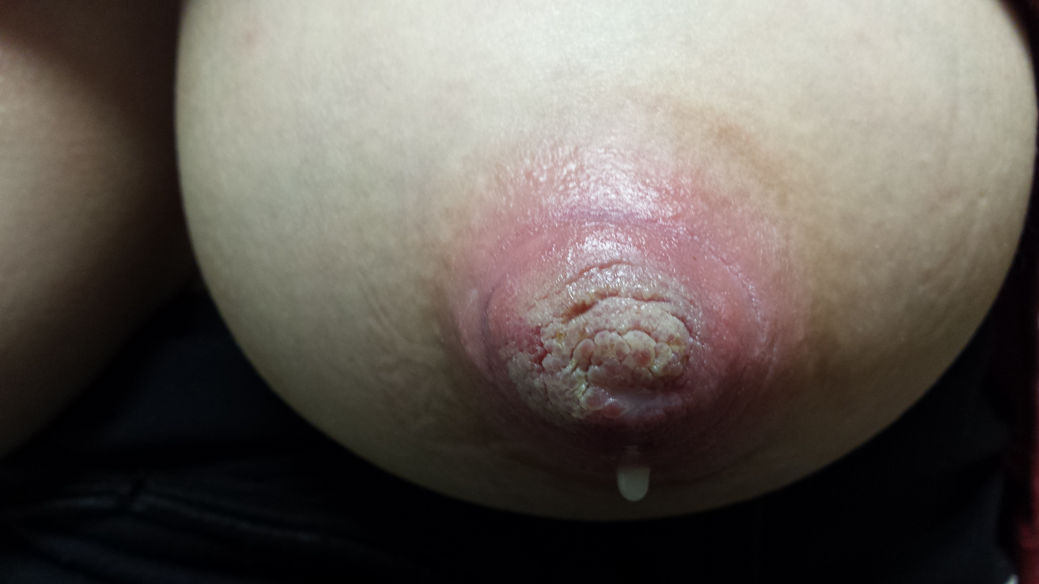

Slide 45
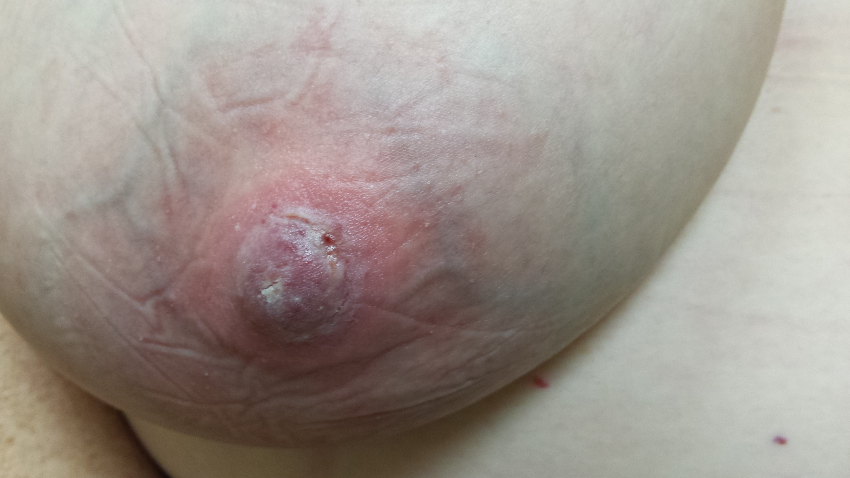

Slide 46
Management
Often thought to be yeast
This is a bacterial-overgrowth situation.
Need an exam and breastmilk culture.
  Typical isolate is coag neg staph
Reduce oversupply if present
Possible prolonged course of antibiotics
  Sulfa, clindamycin, erythromycin, occasionally +sensitive to oxacillin (diclox, cephalexin, augmentin)
Probiotic with lactobacillus salivarius

Slide 47
Other Pathology
Viral infections
  Shingles
  Herpes simplex
Vasospasm
Nipple Dermatitis
Other nipple trauma
Plugged Ducts

Slide 48
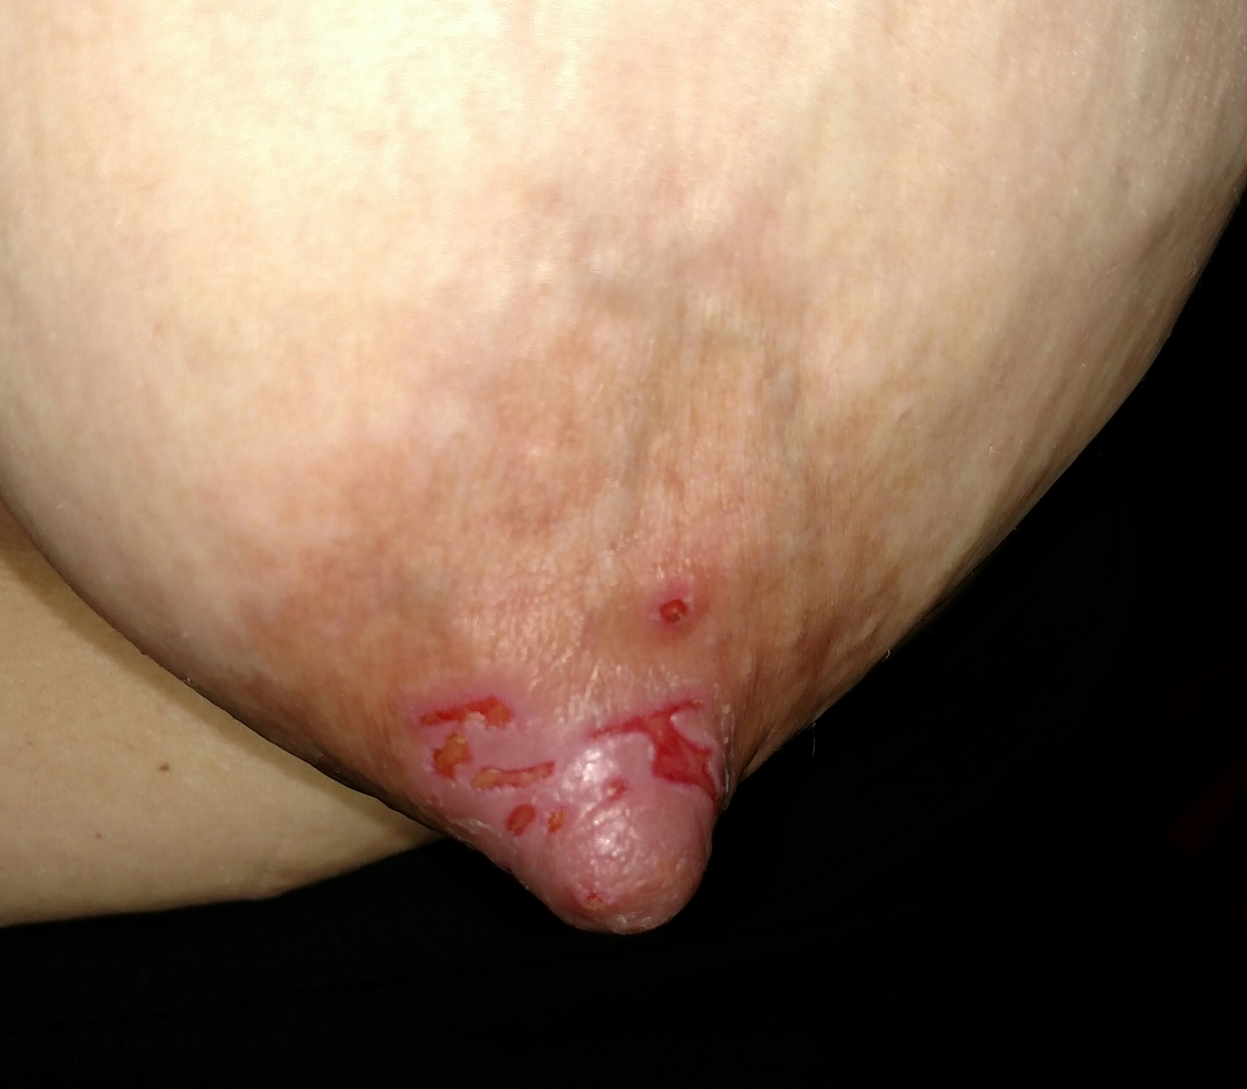

Slide 49
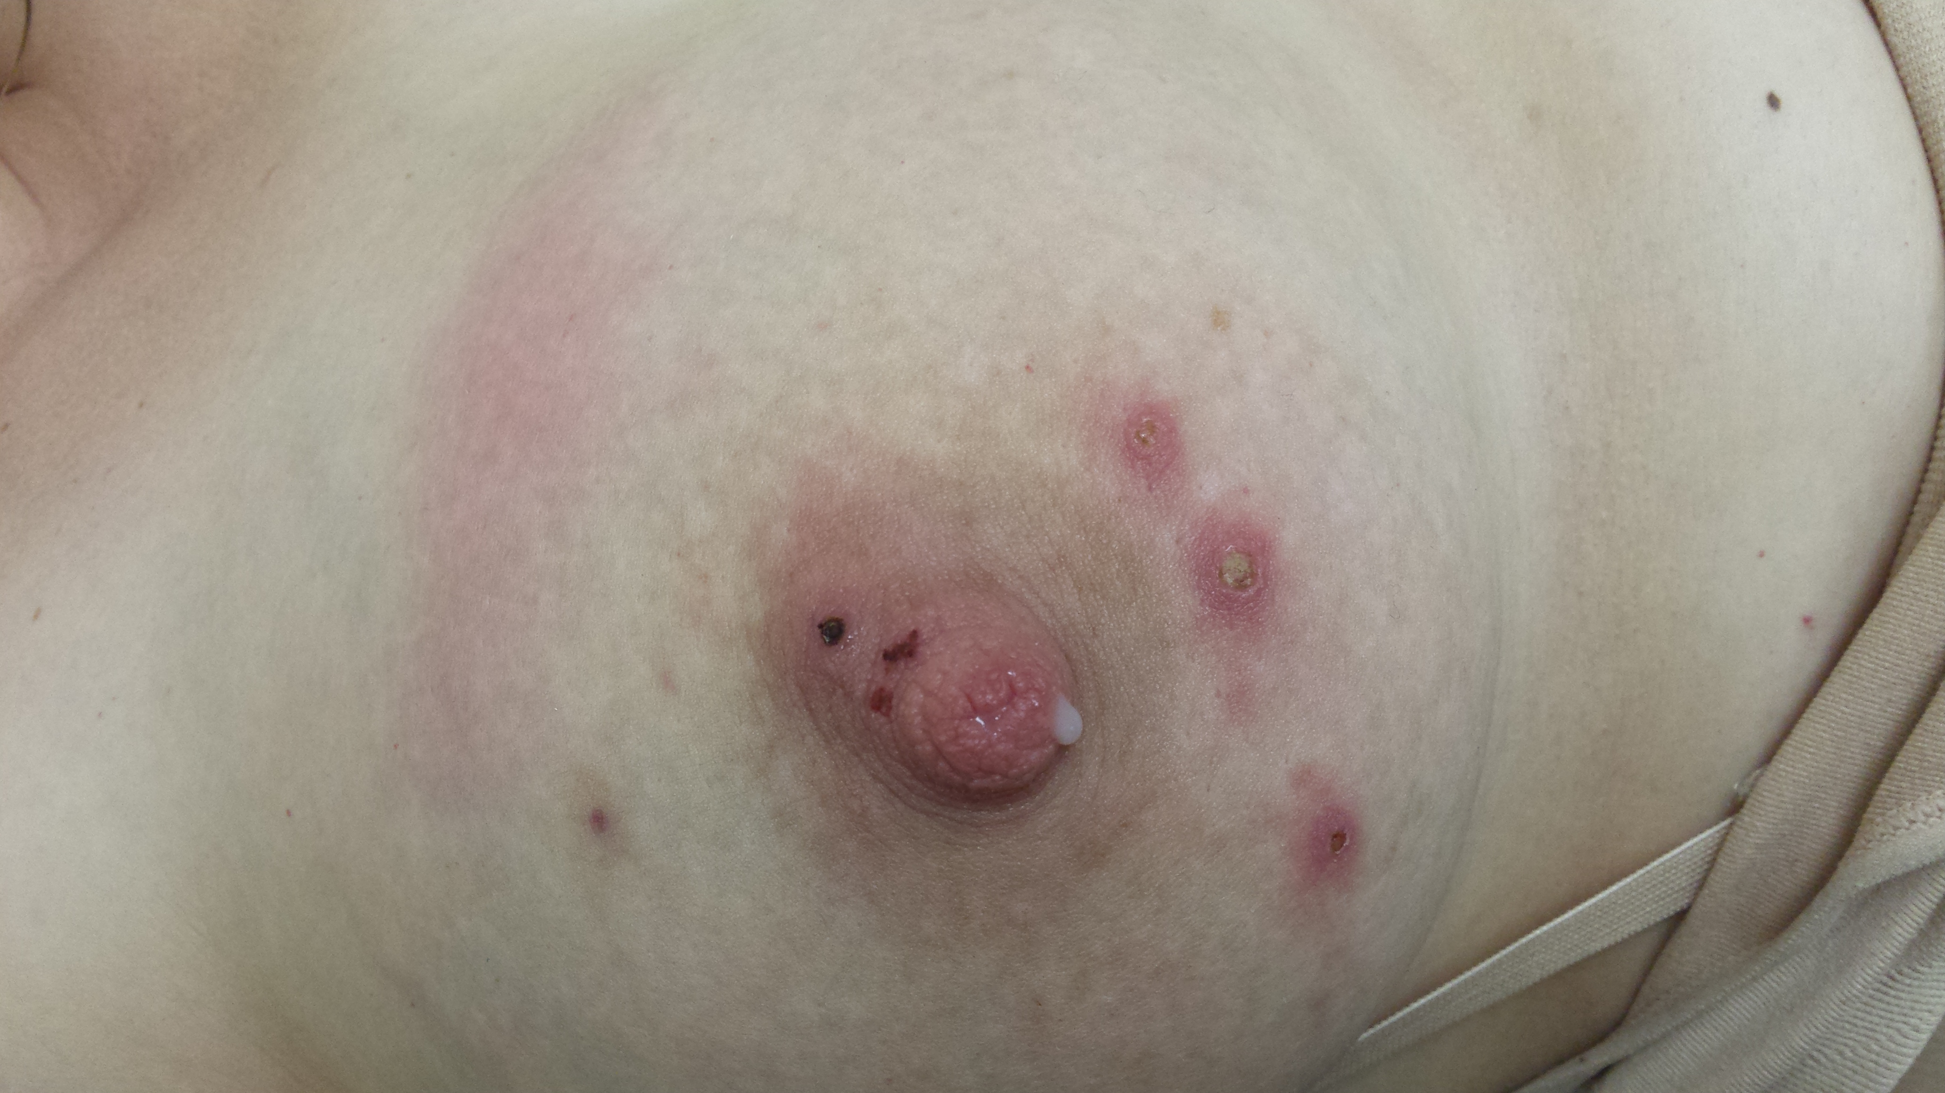

Slide 50
Herpes and Shingles on the Breast
Shingles- Reactivated Chickenpox
  Lesions can spread chickenpox
  Along a dermatome from back to breast
Herpes Simplex
  Can cause herpes in infant
  Often given to moms from nursing toddler
For both
  avoid direct contact of lesions with baby
  pump that side and dump milk
  OK to nurse on the other side
  Keep breast and lesions covered until scabbed over
Antiviral medications are safe with nursing

Slide 51
Classic Sx and Signs of Vasospasm (Raynauds) of the Nipples
Nipple turns pale-blue-red
  Vasospasm
Nipple/ breast pain lasting 5-45 minutes
Triggered by cold, suck, pressure
  Not just associated with feeding
Color changes are assoc with pain

Slide 52
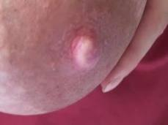

Slide 53
Primary vs Secondary Vasospasm
Primary
  Pain only with vasospasm
  Nipples progress to cyanosis
  Not always associated with feeding
  No other breastfeeding problem identified
Secondary
  Vasospasm not clearly associated with pain
    Pain is relatively constant, vasospasm comes and goes
  Caused by trauma, infection
  Usually just blanching, not cyanosis

Slide 54
Treatment of Vasospasm
Avoid infant biting
Apply heat immediately after nursing
  Heating pad applied after nursing
Keep breasts/nipples warm
Pharmaceutical treatment
  Nifedipine, verapamil

Slide 55
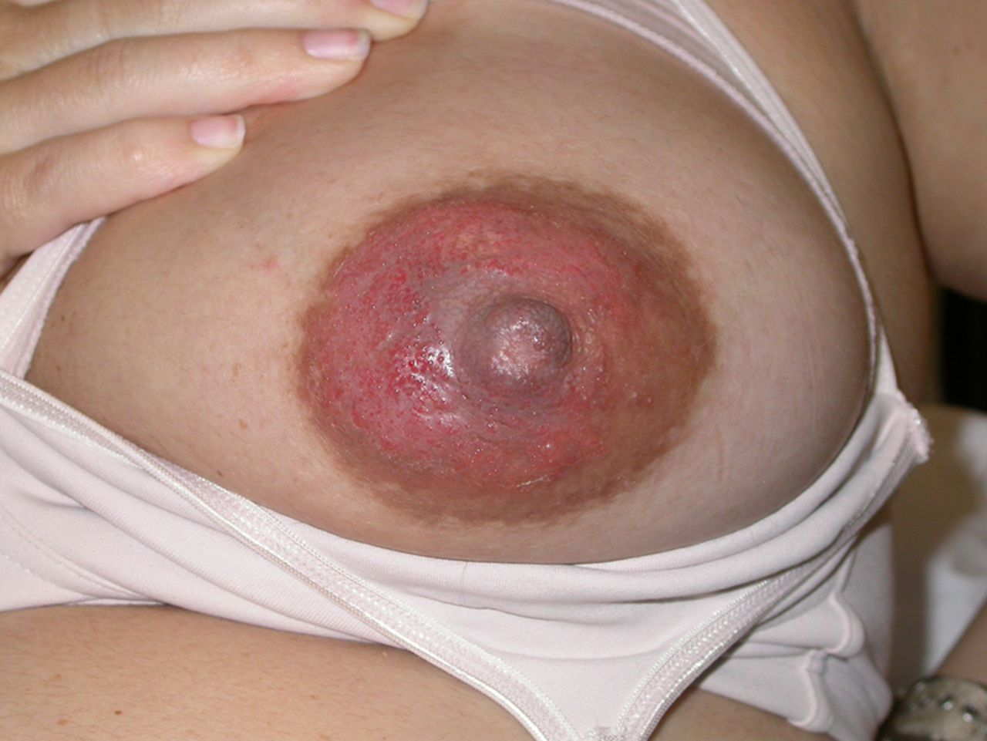
Nipple Dermatitis

Slide 56
Nipple Dermatitis
Possible causes
  Allergic reaction
    Infant food or medication
    Laundry detergent in bra
    Material in breast pad
  Chronic Eczema
  Chronic Psoriasis
Symptoms
  Itchy and/or painful nipple/areola
  Cracks/scabs, red and inflammed
  Oozing of open areas

Slide 57
Treatment of Nipple Dermatitis
Identify possible cause of dermatitis
Triamcinolone ointment 3 times a day
  Vaseline at other times
Rule out a bacterial infection
  Nipple culture for a staph infection
  If + staph aureus, treat with oral antibiotics and mupirocin ointment

Slide 58
Plugged Ducts
Risk factors
  High milk supply
  Returning to work or maternal/infant separation
  Longer duration of sleeping over night
  Irregular feeding pattern
  Restrictive clothing/underwire bra
  Stress, fatigue, poor fluid intake
  Low grade ductal bacterial infection

Slide 59
Plugged Ducts
Symptoms
  Tender localized area of fullness and possible lump
  Pain radiates to/from the nipple during nursing
  No breast redness or fever
  Lower supply/breast does not fully drain

Slide 60
Plugged Duct
Treatment
  Rest
  Frequent and complete drainage of the breast
  Heat and massage to drain the area
  Vary nursing positions
  If the lump does not resolve in 48 hours, consider an ultrasound
  A ‘plug’ that lasts more than 48 hours should not be considered a plug!
  Lecithin 1200mg twice a day for recurrence

Slide 61
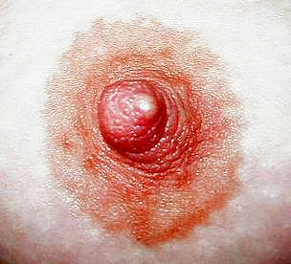

Slide 62
Nipple Blebs
Inflamed pore
  Often starts as a plug
Treatment
  Often don’t need to be treated
  Steroid ointment to reduce inflammation
  Keep nipple well-moisturized
    Olive oil
    Lanolin
  Occasionally provider can unroof

Slide 63
‘Other’ Nipple Trauma
Pump trauma
Frost bite
Infant bite/bruising/pinching
Burn
Wet swimming suit all day

Slide 64
Conclusions
Sore nipples are very common in nursing mothers.
Most sore nipples heal with proper positioning and latch.
Bacterial infections, viral infections, dermatitis, and vasospasm are the most likely reasons for nipple and breast pain unrelated to nipple trauma from latch.

