Slide 1
Basic Approach to Documentation for Lactation Visits
Anne Eglash MD, IBCLC, FABM
University of WI School of Medicine and Public Health
Department of Family Medicine

Slide 2
Conflicts of Interest
None

Slide 3
Objectives
Provide 2 reasons why an organized method of documentation is important for care of the nursing dyad.
Explain the difference between subjective and objective information.
Recognize the importance of maternal and infant past medical history in providing lactation management.
Recite at least 3 important physical findings for documentation regarding the mother, and 3 regarding the infant.
Identify 2 important features of an assessment and plan.

Slide 4
Reasons for Documentation
Legal Record
Communication to others on the care team
Patient education
Remind oneself of history, exam, assessment and plan of care
Routine method improves time efficiency

Slide 5

Lactation Documentation
Nothing else like it
Caution about disclosing information about mother to the pediatric provider without her permission

Slide 6
SOAP
Subjective Information
Objective Findings on Exam
Assessment of the problem(s)
Plan of Care

Slide 7
What is Subjective Information?
Information that the patient/client shares
Patient’s/client’s own words
Reflects what happened, what was experienced
‘Information Gathering’
Does not include findings on exam, assessment, or advice given

Slide 8
What Subjective Info Shall We Gather?
Chief complaint
History of Present Illness
Maternal Past Medical History
Maternal Past Breastfeeding History
Infant Past Medical History
Social History for Mom and Baby
Review of Systems for Mom/Baby

Slide 9
Chief Complaint
What is (are) the main reason(s) for seeing you today?
  Helps focus the visit
  Allows you to organize your time

Slide 10
History of Present Illness
Prenatal history
Events of L&D
Intrapartum or postpartum complications for mother or baby
Breastfeeding play-by-play postpartum
Current breastfeeding history
Description of current breastfeeding problem(s)

Slide 11
Chief Complaint
JB is here for sore nipples.
Prenatal/Intrapartum History
She gave birth to her first baby Luke 7 days ago at 39 weeks gestation. She had no pregnancy problems. Labor and delivery were unremarkable, NSVD. The baby was born at 3250 grams
Breastfeeding Postpartum
After birth, the baby was fussy with latch, and latch hurt. The baby nursed every 3 hours in the hospital and was not supplemented. Her nipples were cracked at time of discharge on day 2.
Not Subjective!
Since being home, she is nursing the baby every 3-4 hours. and now the baby is 2895 grams. We discussed that the baby’s weight is down 11%, and he might need supplementation.

Slide 12
Chief Complaint
JB is here for sore nipples.
Prenatal/Intrapartum History
She gave birth to her first baby Luke 7 days ago at 39 weeks gestation. She had no pregnancy problems. Labor and delivery were unremarkable, NSVD. The baby was born at 3250 grams.
Breastfeeding Postpartum
After birth, the baby was fussy with latch, and latch hurt. The baby nursed every 3 hours in the hospital and was not supplemented. Her nipples were cracked at time of discharge on day 2.

Slide 13
History of Present Illness
Prenatal history
Events of L&D
Intrapartum or postpartum complications for mother or baby
Breastfeeding play-by-play postpartum
Current breastfeeding history
Description of current breastfeeding problem(s)

Slide 14
Current Breastfeeding History
Frequency of Feeding
Quality – duration, difficulty with latch, positions, one side vs both
Infant behavior at the breast and other times
Longest stretch of not feeding
Supplementation
Frequency of pumping/manual expression
Infant voids/stools
Breast fullness/engorgement
  Maternal impression of milk supply
Any recent infant weights

Slide 15
HPI Current Feeding History
Frequency of Feeding
Quality – duration, difficulty with latch, positions, one side vs both
Infant behavior at the breast and other times
Longest stretch of not feeding
Supplementation
Frequency of pumping/manual expression
Infant voids/stools
Breast fullness/engorgement
  Maternal impression of milk supply
Any recent infant weights
Since being home, she is nursing the baby every 3-4 hours day and night.
The baby is hard to keep awake.
He will only nurse on one side, then falls asleep.
Mom tries to keep him awake.
She has to wake him up for the next feeding.
Her breasts feel full, she is not pumping.
It is not hard to latch him on, but latch hurts.
The baby has 3 stools and 5 voids daily.
The baby weighed 2895 grams yesterday, 11% down from birthweight so she was told to see you today.

Slide 16
Current Breastfeeding Concerns
Listen to mother and other supporters who are with her
After hearing all they want to share, ask questions

Slide 17
Current Breastfeeding Concerns
JB complains that her nipples hurt.
She has pain with latch, which does not improve during feeding.
She has cracks of her nipples which bleed at times.
She dreads feeding her baby, and is worried that she always has to wake her baby up to feed.
Her family members wonder if she should just pump and give the baby a bottle, so JB does not have as much pain. Also JB can get more sleep while others feed the baby.
You may ask:
Has she had a fever or breast redness?
Did she have significant engorgement?
How is she caring for her nipples?
What positions does she use to nurse the baby?
Does she use any supports for her or the baby’s position?

Slide 18
What Subjective Info Shall We Gather?
Chief complaint
History of Present Illness
Maternal Past Medical History
Maternal Past Breastfeeding History
Infant Past Medical History
Social History for Mom and Baby
Review of Systems for Mom/Baby

Slide 19
Maternal Past Medical and Breastfeeding History
Past illnesses
  Illnesses that required hospitalizations or medications, or frequent office visits
Previous breast surgery
Current medications & supplements
Allergies to medication/food
Breastfeeding experiences with previous children

Slide 20
JB reports that this is her first baby, so no prior breastfeeding history.
She had a breast biopsy of her R breast 3 years ago for a benign lesion.
She has a history of gastroesophageal reflux and anxiety
Her medications include:
  Ranitidine 300mg each evening
  Alprazolam 1mg every 8 hours for anxiety
She is allergic to penicillin and to peanuts
Past Medical and Breastfeeding History
Past illnesses
  Illnesses that required hospitalizations or medications, or frequent office visits
Previous breast surgery
Current medications & supplements
Allergies to medication/food

Slide 21
What Subjective Info Shall We Gather?
Chief complaint
History of Present Illness
Maternal Past Medical History
Maternal Past Breastfeeding History
Infant Past Medical History
Social History for Mom and Baby
Review of Systems for Mom/Baby

Slide 22
Infant Past Medical History
JB’s baby boy, Luke was born at 39 weeks gestation
No fetal concerns
He had no problems in the hospital
He has a circumcision
He does not take medication other than vitamin D

Slide 23
What Subjective Info Shall We Gather?
Chief complaint
History of Present Illness
Maternal Past Medical History
Maternal Past Breastfeeding History
Infant Past Medical History
Social History for Mom and Baby
Review of Systems for Mom/Baby

Slide 24
What Social History
Do We Need?
Living situation
  What is the family unit?
Employment/income situation
Maternal work plans
Day care plans
Family alcohol, illicit drug, tobacco history
Infant sleep space
Social support

Slide 25
JB and Luke live with baby’s dad, and paternal grandfather
Grandpa owns the home and helps pay for expenses
Grandpa smokes in the home
Dad is unemployed
Mom back to work at 4 months
Mother has a few close friends, but no support from her family
Mom and dad do not smoke
Mom has 1 beer a day
Dad drinks more
No one uses illicit drugs
Baby sleeps in parents’ room on a futon on the floor
There is a golden retriever and a cat in the house
Dad and grandpa will take care of baby when mom goes to work
Social History
Living situation
  What is the family unit?
Employment/income situation
Maternal work plans
Day care plans
Family alcohol, illicit drug, tobacco history
Infant sleep space
Social support

Slide 26
What Subjective Info Shall We Gather?
Chief complaint
History of Present Illness
Maternal Past Medical History
Maternal Past Breastfeeding History
Infant Past Medical History
Social History for Mom and Baby
Review of Systems for Mom/Baby

Slide 27
Review of Systems
Any other symptoms or concerns that mom might have for herself or her baby.
May need to elicit concerns
  Infant
    Fussiness
    Diaper rash
    Sleep issues
  Maternal
    Eczema
    Diarrhea
    Fatigue
    Depression

Slide 28
JB reports that she has a history of eczema, which worsens when she is anxious.
Her anxiety is worse lately due to having this baby, worried about finances.
Her partner’s father smokes heavily in the house, which worries her.
She has trouble sleeping at night.
The baby has been spitting up at times and she wonders if this is causing the baby to not gain well.

Slide 29
SOAP
Subjective Information
Objective Findings on Exam
Assessment of the problem(s)
Plan of Care

Slide 30
What is Objective Information?
Measured
Observed
Findings on exam
Interventions during exam
Test results

Slide 31
Objective Findings
Maternal Exam
  General appearance, mood
  Vitals
  Breasts
  Nipples/areola
Infant Exam
  General appearance
  Vitals, weight
  Color, jaundice
  Developmental- tone, milestones
  Head, neck, mouth
Breastfeeding Exam
  Relationship between mom/baby
  Positioning
  Latch
  Suck/swallow
  Mom’s management of feeding
  Infant behavior
  Milk Transfer
Interventions
  Pumping
  Change in positions/latch
  Tongue clipping

Slide 32
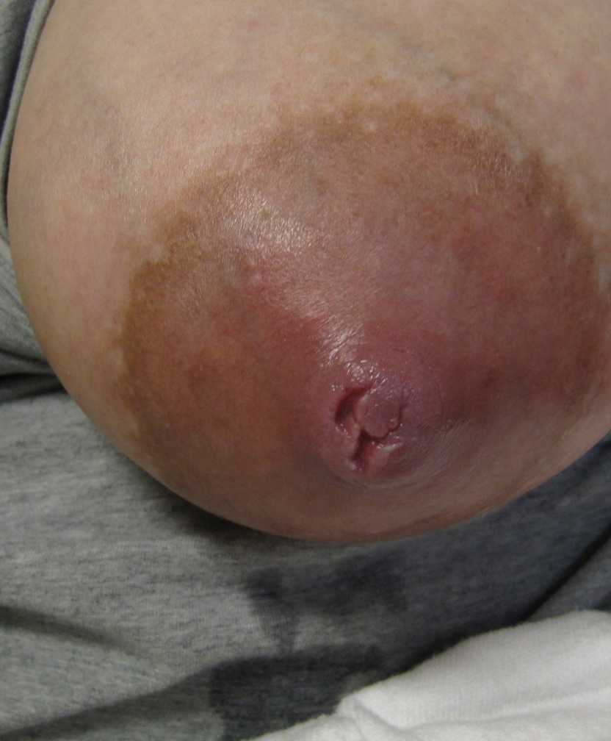
JB Maternal Exam
JB is tearful, anxious
Vitals are normal
Her breasts appear large in size, normal contour. They are moderately full
Nipples are open at the tips, not bleeding
Breast exam- no tenderness, redness, masses

Slide 33
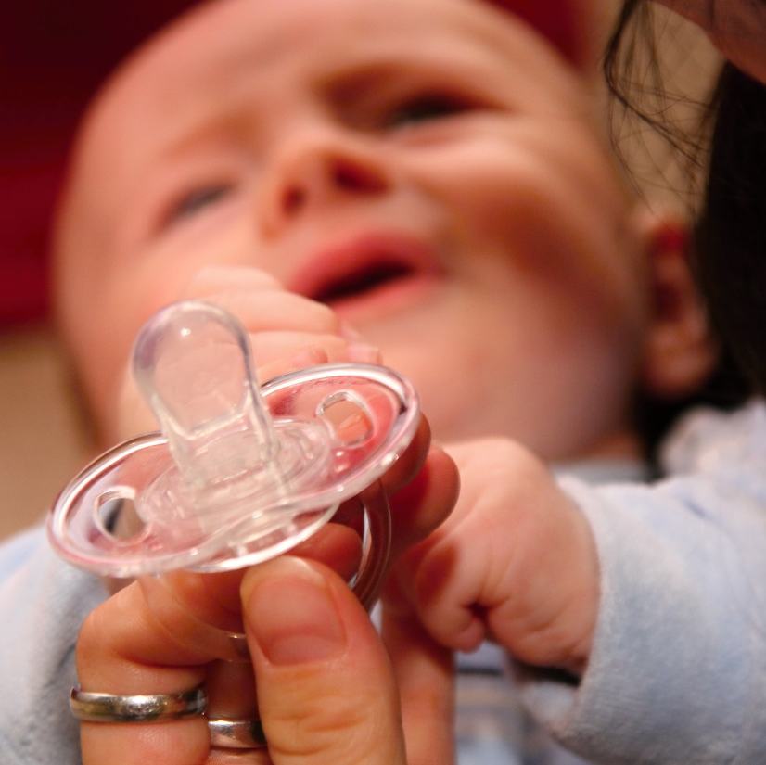
Infant Exam
Baby appears slightly agitated, hungry
Weight is 2865g, down another 30g from yesterday
No torticollis
Mild jaundice of face
No tongue tie, no thrush, no oral lesions

Slide 34

Breastfeeding Exam
Mom sits w/o support
Places infant to the breast in a nice hold
Mom demonstrates pain with latch
Latch appear shallow
Baby falls asleep after a series of swallows
Baby won’t awaken to feed on the other side
Milk transfer is 27ml
Mother expressed 120ml with her pump after nursing
We worked on improving positioning with pillows, and asymmetric latch
We worked on ways to keep the baby awake

Slide 35
SOAP
Subjective Information
Objective Findings on Exam
Assessment of the problem(s)
Plan of Care

Slide 36
Assessment
List problems that need to be addressed
  Discuss contributing factors
  Work up that has already been done
  Problems may be due to or related to each other
Document discussion about problems

Slide 37
Assessment of Our Case
Infant sleepiness
Sore nipples
Latch issues
Insufficient infant weight gain
Maternal anxiety
Maternal psychosocial stress
Financial stress
Tobacco exposure

Slide 38
1. Infant Sleepiness- does not appear ill, may be due to insufficient calorie
intake. Maternal use of alprazolam might be contributing
2. Sore Nipples- may be due to poor latch, nonnutritive sucking due to
infant sleepiness at the breast
3. Latch issues- likely due to sleepiness, and maternal positioning
4. Insufficient infant weight gain- due to infant sleepiness. Maternal milk
supply appears adequate. We discussed options for
supplementation using a bottle or cup. Mother is most comfortable
with a bottle
5. Maternal anxiety and stress- close follow-up with her primary care
physician is needed for improved control of her anxiety. She may benefit
from a local support group. Her alprazolam might be having an adverse
effect on the baby.
6. Financial stress- she may benefit from social services evaluation for
assistance
7. Tobacco exposure- the patient expresses awareness of the dangers of
tobacco smoke exposure to her baby and her own health.

Slide 39
Plan
What you recommend
  Feeding plan
  Referrals
  Medications
  Tests
What you might do at the next visit
Follow up plans

Slide 40
Plan for Our Case
Feeding Plan
  Pump after each nursing and supplement using a bottle
  It is fine to skip some feedings at the breast
  Keep the baby awake by stripping down the clothes, tickle feet, stimulate back, tickle neck
  Use pillows to help support the baby at the breast
  Use the asymmetric latch technique for a deeper latch

Slide 41
Plan for Our Case
Mother will use an antibiotic ointment on her nipples with a nonstick pad, changing after each feeding.
Mother will talk to her physician about her anxiety medication, which may be causing infant sleepiness.
Mother is given a phone number for social services, for financial resources.
A handout on tobacco exposure and SIDS is given for the family to read.
Mom will be seen back in 3 days for infant weight check, recheck feeding and follow-up of her sore nipples.

Slide 42
Conclusions
Organized documentation allows for
  Comprehensive assessment
  Ideal communication to other members of treatment team
  Efficient use of time
  Organized instructions to mother/family

