Slide 1
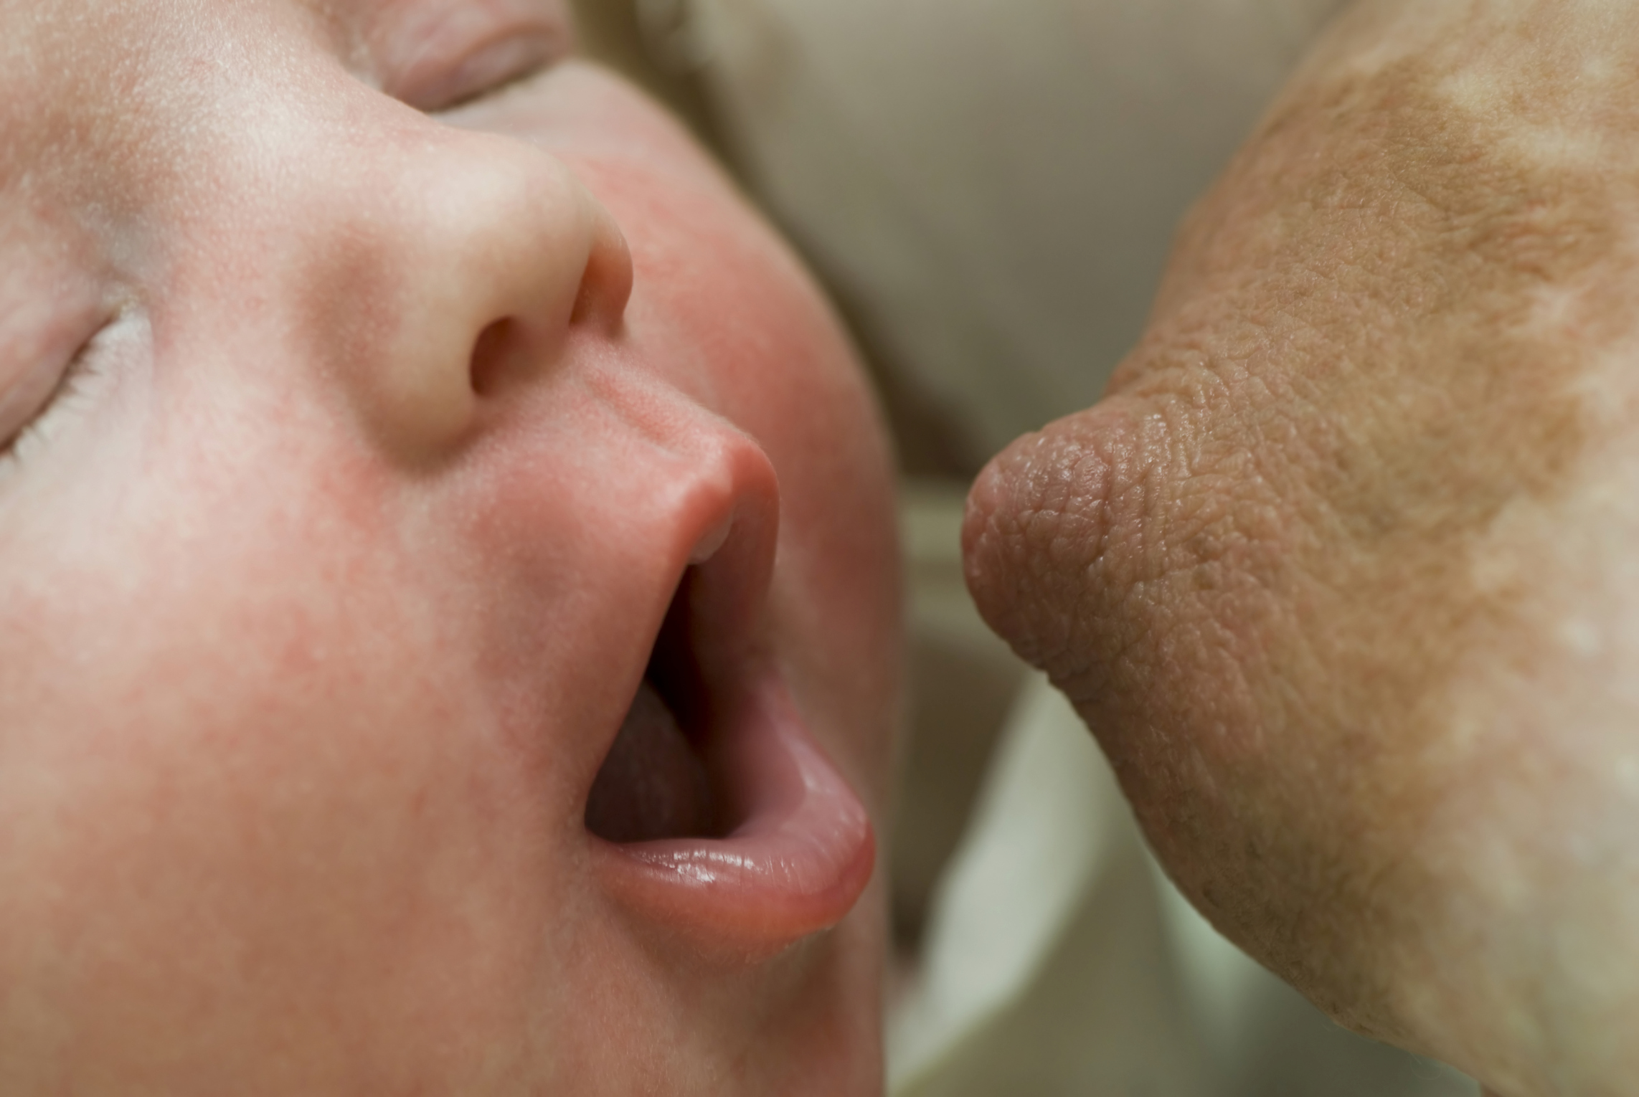
Breastfeeding Basics for Early Success
Anne Eglash MD, IBCLC, FABM
Clinical Professor
Dept of Family Medicine
University of Wisconsin School of Medicine and Public Health

Slide 2
Conflict of Interest
None

Slide 3
Objectives
Identify 3 prenatal risk factors for insufficient milk supply.
List 3 strategies to support breastfeeding when a newborn won’t latch.
Describe 3 strategies to help mothers who develop sore nipples in the hospital.

Slide 4

Prenatal Factors for
Low Milk Supply

Slide 5
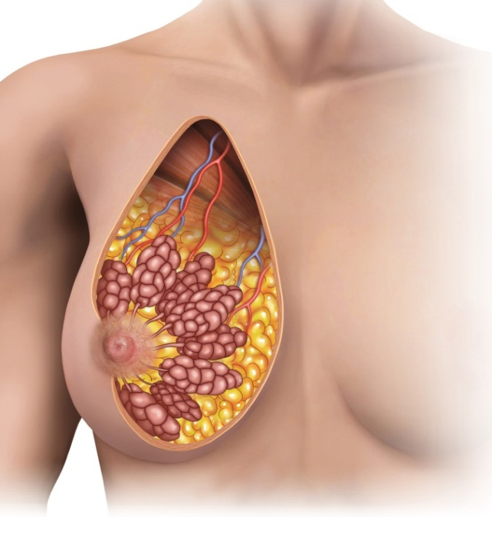
alveolus
lobule
fat
Lactiferous duct
Notes:
This is a picture of breast anatomy (note that the words come one by one with each click)
Alveolus- each individual grape-like structure is called an alveolus. They are clustered together like grapes on a vine, and share ducts. Each alveolus is lined with cells that make milk. The milk is expressed from each cell into the center of each alveolus, as we will see later.
Lobule- a lobule is a cluster of alveoli, which share common ducts.
Fat- Fat surrounds the glandular tissues that make milk
Lactiferous duct- Breastmilk travels from the alveoli down these ducts, eventually reaching the pores of the nipples.

Slide 6
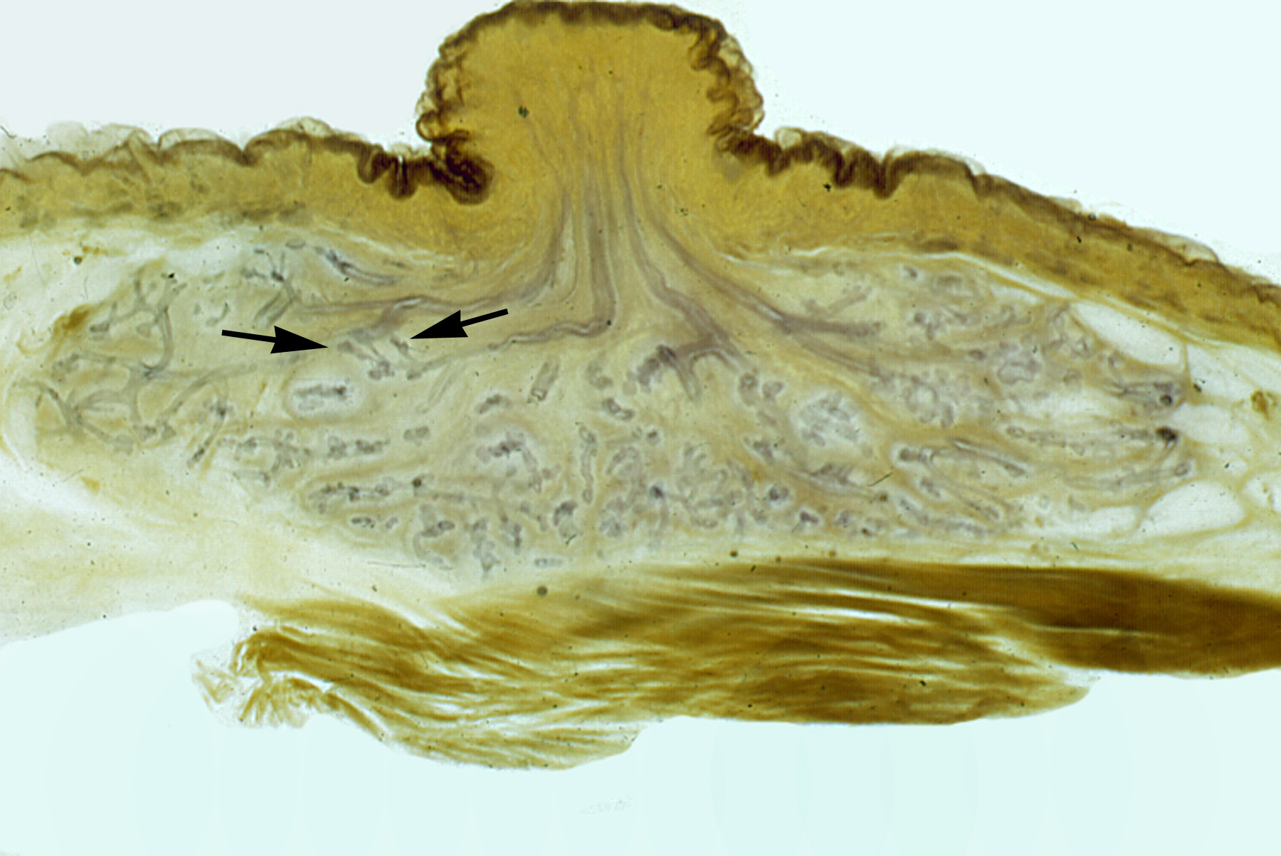

Slide 7
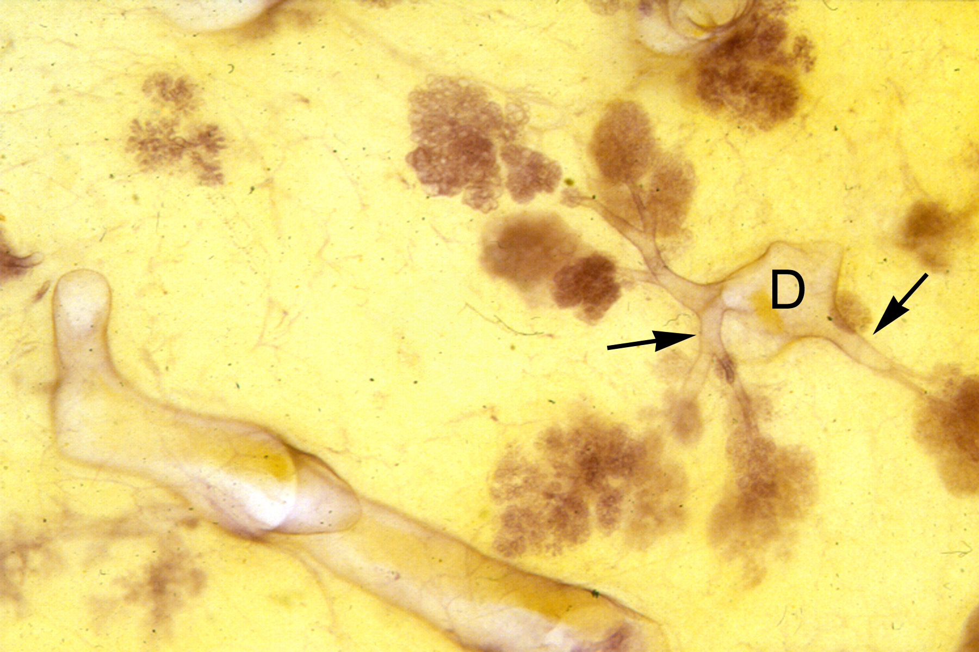

Slide 8
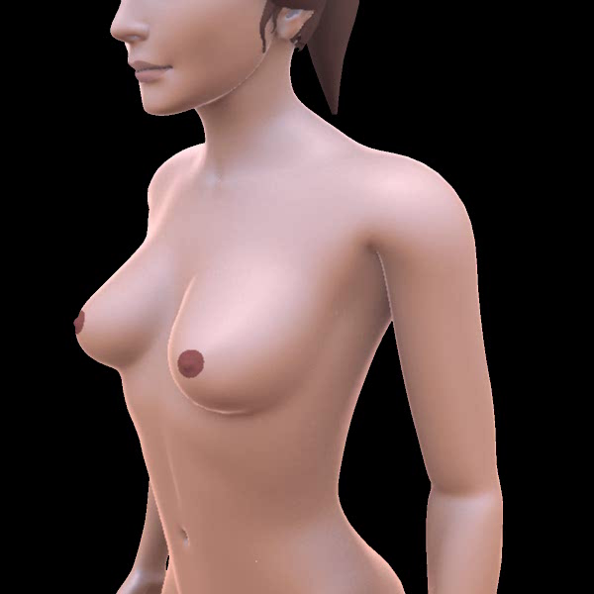
Notes:
Mouse over the bottom of this picture, to show this animation.
First you will notice the extensive lymphatic tissue around the breast.
The animation then focuses on a side view of an alveolus. You can see how the alveolus is lined with milk producing cells. The milk gathers in the center of the alveolus. The alveolus contracts and forces milk through the ducts and then out of the breast.

Slide 9
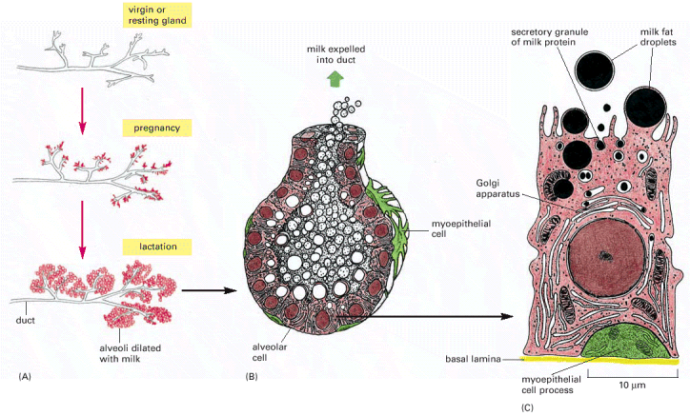

Slide 10
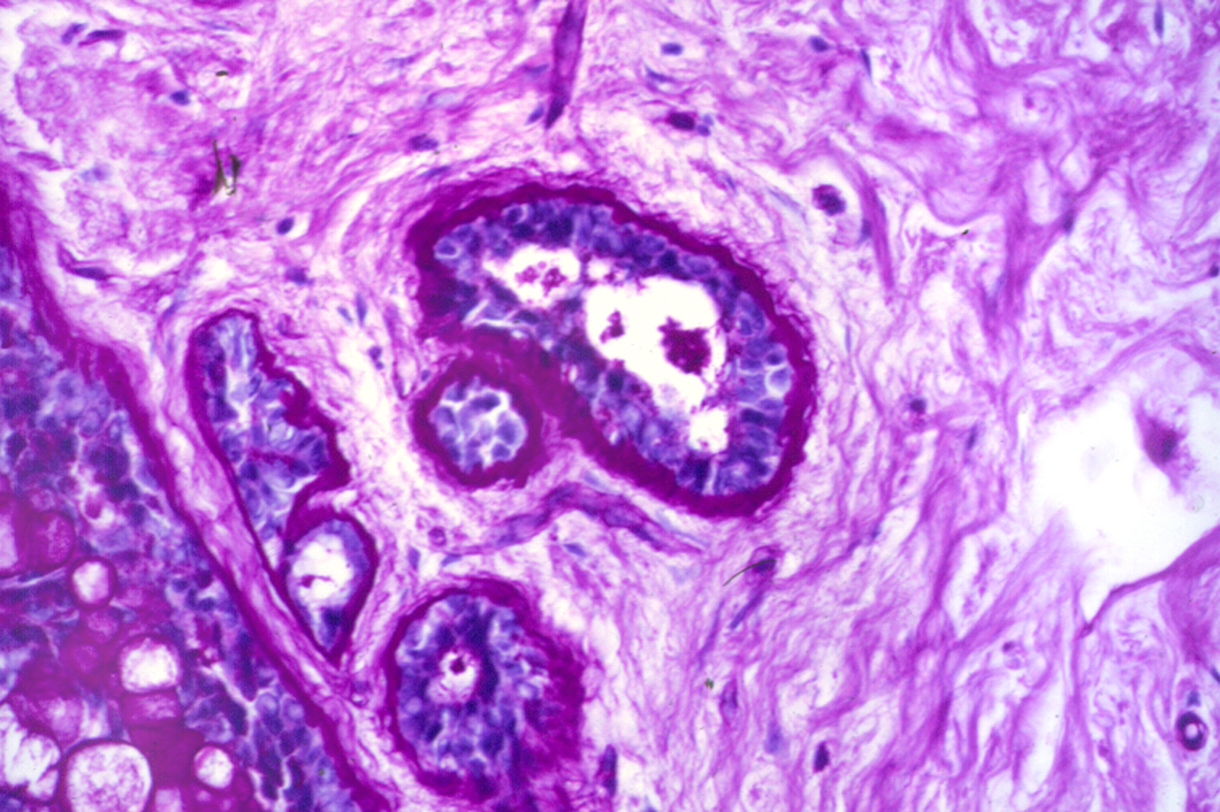

Slide 11
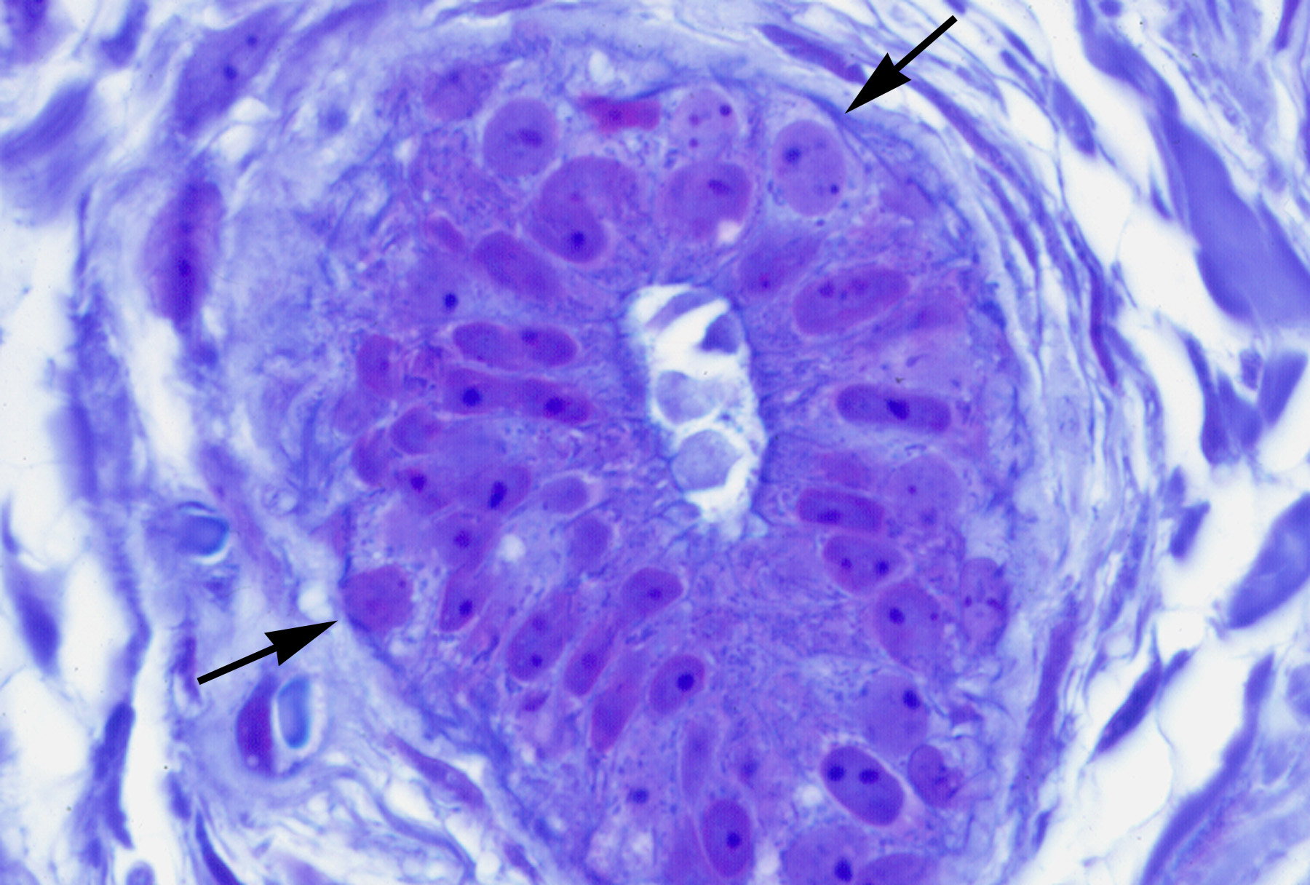

Slide 12

Estrogen
Parathyroid hormone
related protein
Progesterone
Human Placental Lactogen
Insulin-like Growth Factor
Prolactin
Fibroblast Growth Factor
Growth Hormone
Notes:
Placenta stimulates the breasts to grow

Slide 13





Slide 14
Lactogenesis
In Pregnancy
Ache and grow
Increase in protein, lactose, Ig,
Leaky
differentiate

Slide 15
Little-No Breast Changes in Pregnancy
Little Breast Change
Insufficient Glandular Tissue
Congenital
Acquired
(ie surgery, radiation)
Hormonal Interruption
PCOS, Obesity, High Androgens

Slide 16

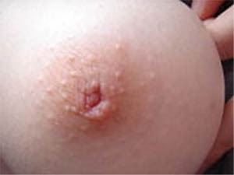


Slide 17
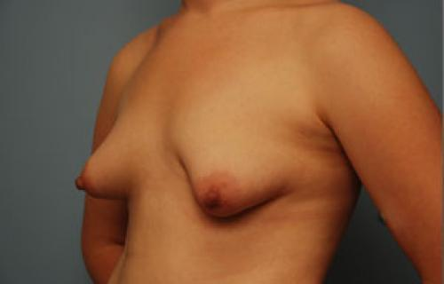

Slide 18


Slide 19
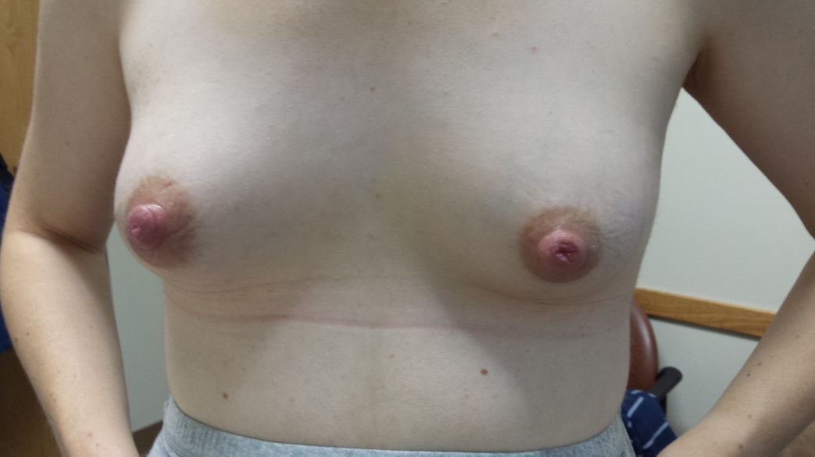
Insufficient Glandular Tissue
Small amount of glandular tissue
Trauma to the breast tissue as a child
Breast Surgery;reduction, lumpectomy
Breast radiation

Slide 20

Normal Appearing Breasts but Lack of Full Growth
High Androgen States
  Obesity
  Polycystic Ovarian Syndrome
  Gestational Diabetes
  Pre-eclampsia

Slide 21
Obesity and Breastmilk Supply
Rasmussen Peds 2004 May; 113(5):
  e465-71-lower prolactin response to suckling at 48 hrs among high BMI moms
Dewey Peds 2003;112 607-619.
  BMI>27 assoc with delayed lactation
Hillson JHL 2004:20. 18-29
  RR of obesity for early termination of lactation=2.37 (CI 1.07-4.5)
Donath J Paediatr Child Health 2000:36 482-86 Lower rates of initiation and duration with BMI>30

Slide 22
Red Flags for Breastfeeding Problems
Little or no breast growth in pregnancy, esp. if h/o PCO or infertility.
Inverted nipples that don’t evert.
History of breast radiation or surgery, esp. reduction.
H/o low milk supply in past.
Medications that inhibit letdown or decrease milk supply.
Notes:
Show cup feeding and finger feeding videos

Slide 23
Lack of Sufficient Breast Development
Important to identify early pp
  If little growth in preg, follow closely.
Hard to diagnose during pregnancy.
  No good prospective studies.

Slide 24

Getting off to a Great Start

Slide 25

The Newborn Who Won’t Latch
© 2016 The Milk Mob. 25

Slide 26

No Latch in the Hospital
Variable nursing day 1
Improved nursing skills by day 2
Express milk by 24 hours if no latch
  Avoid a nipple shield
  Supplement with colostrum
  Keep baby skin-skin
Source: United States Breastfeeding Committee
© 2016 The Milk Mob. 26
Notes:
No Latch in the First Several Days of Life
Variable nursing day 1:
It is normal for babies to not nurse well the first day. The baby might have a stomach full of amniotic fluid, have to pass thick meconium, and may be quite sleepy, or have some discomfort from the birth process.
Latch and feeding usually improves by day 2.
If the baby has not started nursing 24 hours,
Mom should begin pumping and manually expressing every 3 hours. Encourage mom to be patient, and supplement the baby with colostrum, using a spoon or finger feeder
Encourage mom to be skin to skin as much as possible with the baby, to encourage latch naturally
By day 2 most babies are rapidly improving their breastfeeding skills.

Slide 27
Non-latching Baby
Bottle preference
Low milk supply
Anatomic or motor issues
Sleepy and/or premature
Notes:
There are many reasons for a non-latching baby
Common reasons include:
Sleepy or premature infant
Bottle preference- the baby is not confused, but just prefers the bottle, or expects a bottle nipple when ready to feed
Low Milk supply- Mom’s milk supply may be too low for the baby to find it worthwhile to nurse
Anatomic or motor issues- the baby have some some sort of anatomic problem such as a cleft palate, or a motor issue such as low tone as occurs with Down syndrome. Both of these make it hard to latch or sustain a latch.
We will talk more about these issues in the next few slides

Slide 28

Sleepy/Premature
Infant
Falls asleep at the breast
Sluggish suck/swallow reflex
Often needs supplementation until nursing improves
© 2016 The Milk Mob. 28
Notes:
Sleepy and Premature Infant
These babies fall asleep easily at the breast. Premature or babies who are born 35-37 weeks (late premature infants) are at high risk for this behavior.
The soft nipple may not awaken the baby’s suck/swallow reflex, because it is not as firm as a bottle nipple. We reviewed this issue in detail in session 5, our last session.
These babies will often latch, but they don’t initiate a suck without milk flowing rapidly
The bottom line is that these babies often need supplementation until they stay awake while nursing.

Slide 29

Bottle Preference
Babies become imprinted
‘come to recognize (another animal, person, or thing) as a parent or other object of habitual trust’
A bottle has
  firm stimulus to palate
  immediate and low resistance milk flow
Notes:
Bottle Preference
These are typically babies who received a bottle early on, and continue to look for that very firm bottle nipple stimulus against their palate.
They also look for the immediate flow of milk as soon as they start sucking. Often the milk will flow faster with the bottle than the breast, which the babies become accustomed to and prefer.

Slide 30
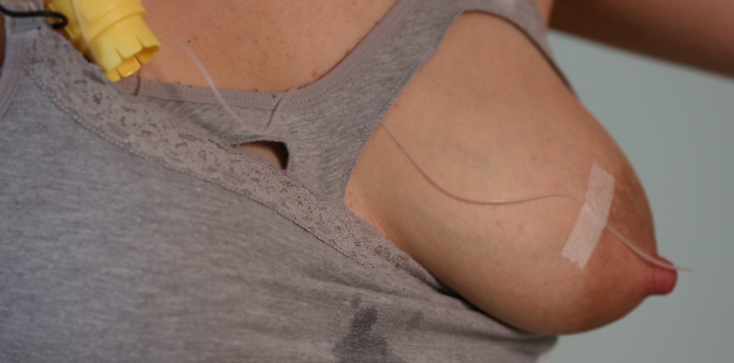
Low Milk Supply
Baby stops latching due to frustration and hunger.
Often has been given bottles or a finger feeder.
Supplementer at the breast helps.
Notes:
Low Milk Supply
Low milk supply can be a cause of the baby not longer latching.
These babies often have a history of nursing well the first few days, but then becomes frustrated when they are hungry and the breastmilk supply is too low. It can be like asking the baby to continue to suck on a pacifier when they are hungry. They won’t, and will just cry.
Sometimes these babies have received bottles or supplementation with a finger feeder, so they decide that they no longer want to go to the breast where the supply is too low.
A supplementer at the breast works well for these babies, because the supplementer will keep them nursing at the breast.

Slide 31

Anatomic and Motor Problems
Tongue Tie
Torticollis
  Won’t latch on one breast
Nasal obstruction
Pain
Flat or inverted nipples
ENGORGEMENT
Source: United States Breastfeeding Committee
Notes:
Anatomic and Motor Problems
Tongue Tie-
These babies have difficulty sustaining a good latch. Some will sustain a latch but it is shallow and painful.
Torticollis
Won’t latch on one breast because it hurts to turn the head slightly to the side
Nasal congestion
This can be due to narrow nasal passages or large adenoids. These babies are mouth breathers, so have trouble staying latched onto the breast.
Pain
Babies can have pain due to a clavicle fracture, or a headache due to a cephalohematoma or forceps delivery. It might hurt to be held in a certain position, or for the baby to turn her head
Flat or inverted nipples
Sometimes babies do have trouble latching deeply onto a breast with flat or inverted nipples, especially if the surrounding areolar tissue is not very compressible, especially with engorgement.
Engorgement
Engorgement is one of the most common reasons why a baby might stop latching on day 3-5. The baby senses that the breast is too hard to compress, the baby cannot latch deeply, so the baby cries when brought to the breast. Softening the breast by manually expressing some milk, or by reverse pressure softening, will help. Reverse pressure softening involves putting pressure around the areola to decrease the swelling in the area.

Slide 32
Skin to Skin for the
Non-Latching Baby
Chest to
Chest
Bobs and
Pecks
Moves Down
To Breast
Roots and
Latches
Notes:
(note- in this slide, each heart comes up with another click)
Skin to skin means to hold the baby chest to chest with mom. The baby is stripped down to the diaper, and the mom is bare chested, no bra or shirt on. Mom should be in a reclining position, not straight upright, and not flat on her back.
Chest to chest
The baby lies between mom’s breasts so they are chest to chest.
Bobs and Pecks
The baby will gradually arouse, and initiate a bobbing and pecking behavior at mom’s chest, which is a hunger cue
Moves down to the breast-
Mom will feel the baby flinging towards one breast or the other. Mom should help guide the baby down in the direction the baby wants to go
Roots and Latches-
The baby will use her cheeks and mouth to find the nipple, and will use her vision to find the areola. Once the baby finds the nipple, the baby will typically latch.

Slide 33
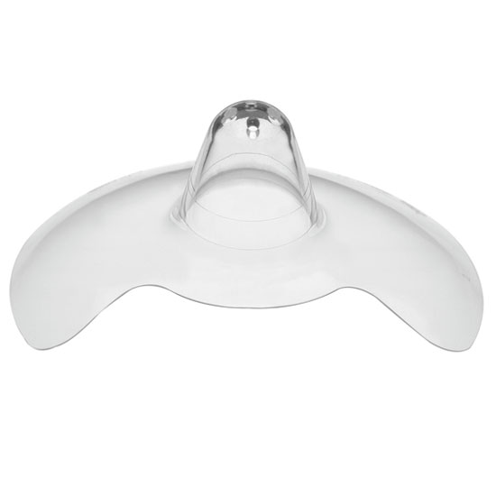
Why Not a Nipple Shield?
An easy fix
Risks of decreased
  Milk supply
  Milk transfer
Need to pump after nursing
Does not teach nursing
Notes:
Why Not a Nipple Shield?
An easy fix
It’s true, a nipple shield could be an easy fix.
Nipple shields might decrease prolactin
Nipple shields can reduce nipple stimulation. This means that the nipple does not sense the suckling as well. This decrease in sensation might decrease the prolactin level, since the prolactin level relies on nipple sensitivity. If the prolactin level drops, the supply will also drop.
Risk of insufficient milk transfer
Babies nurse differently when they use a nipple shield. Sometimes babies transfer milk better with a shield, but the shield does increase the risk that the baby will not transfer milk as well, since the shield might make it harder for the baby to deeply grasp breast tissue.
Mom would have to pump after nursing.
The safest suggestion when using a shield is to have mom pump after using the nipple shield, to help support her milk supply. Some women do not need to do this because they are high milk producers. So, if a woman is using a nipple shield, she should start out pumping after nursing, but if her supply is driven up too much, then it would be best for her to stop pumping after nursing.
A shield does not teach babies to nurse.
There is no evidence that a baby will learn how to nurse by using a nipple shield. In fact, a shield might make it harder for the baby to eventually latch, because the baby keeps looking for the rigidity of the nipple shield when he goes to the breast.

Slide 34
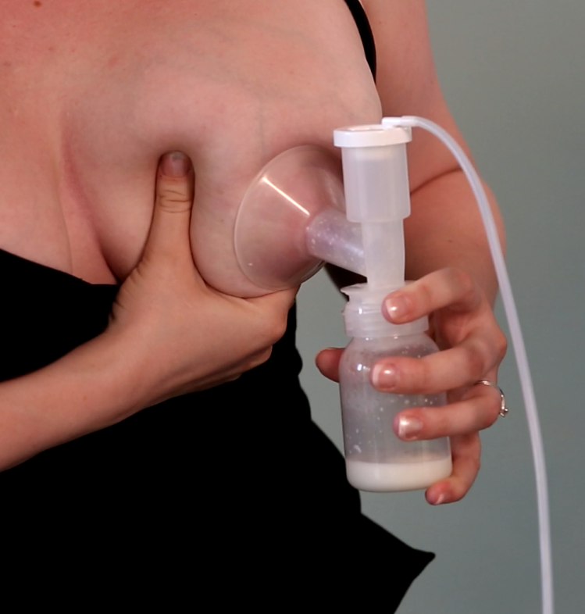
No Latch by Discharge
Hands on pumping q3 hours
Skin-skin
  Infant-led latch
Infant feeding
  Finger feeding
  Cup feeding
Lactation referral

Slide 35
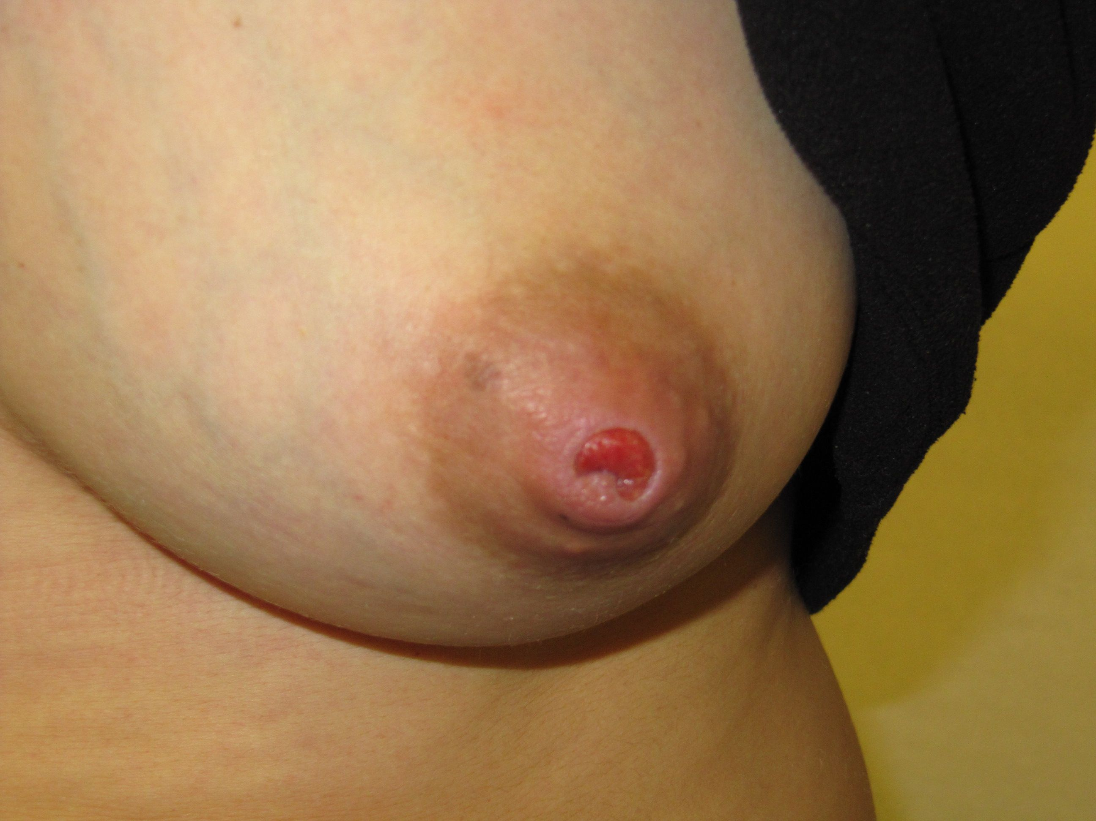
Sore Nipples

Slide 36

Myths re Sore Nipples
Having to ‘toughen up’
The baby having a strong suck
Nursing the baby too much or too long

Slide 37

Nipple Pain Starts Early
  11-96% of have nipple pain at some point
  43% with sore nipples at hospital D/C
  73-76% with sore nipples at 3 days pp, with 19-26% having cracks
Source: United States Breastfeeding Committee
Notes:
Several studies have been done looking to see how common sore nipples are in nursing women.
In one study, 11-96% of all women have nipple pain at some point (Blair A. et al Brfeed Review 2003)
In another study, 43% of mothers had sore nipples at hospital D/C (Oliveira JHL 22(3) 2006)
In addition, it has been found that 73-76% of new moms had sore nipples at 3 days pp, with 19-26% having cracks. (Centuori JHL 15(2) 1999)

Slide 38
Sore Nipples
Position
Latch
Trauma
Infections
Vasospasm
Dermatitis
Pregnancy
Notes:
This slide shows the most common causes of sore nipples and breasts.
We will discuss all of these, except for pregnancy. Most of you (participants) know that women develop sore nipples and breasts in the first trimester of pregnancy.
Pregnancy is a diagnosis to consider for a nursing woman who is several months postpartum, who has new breast pain.
You can see from this slide that the #1 cause of sore nipples and breasts is improper positioning and latch.

Slide 39
Traumatic nursing
Cracked and painful nipples
Nipple /breast infection
Painful nursing
Decreased frequency of nursing
Decrease in milk demand
Engorgement and plugs
Decrease in milk supply
Infant supplementation

Slide 40

Importance
Of Positioning
Deep Latch
Maternal Comfort
Effective Milk Transfer
Notes:
In the next set of slides, we will talk about Positioning the baby.
Proper positioning is important for a few reasons.
Deep latch- The baby must be positioned properly to latch deeply onto the breast, which we will talk about in a moment
Maternal comfort- if the baby is latched on deeply, mom’s nipples will be much more comfortable.
Effective milk transfer- the baby has to have a deep latch in order to transfer milk effectively.

Slide 41
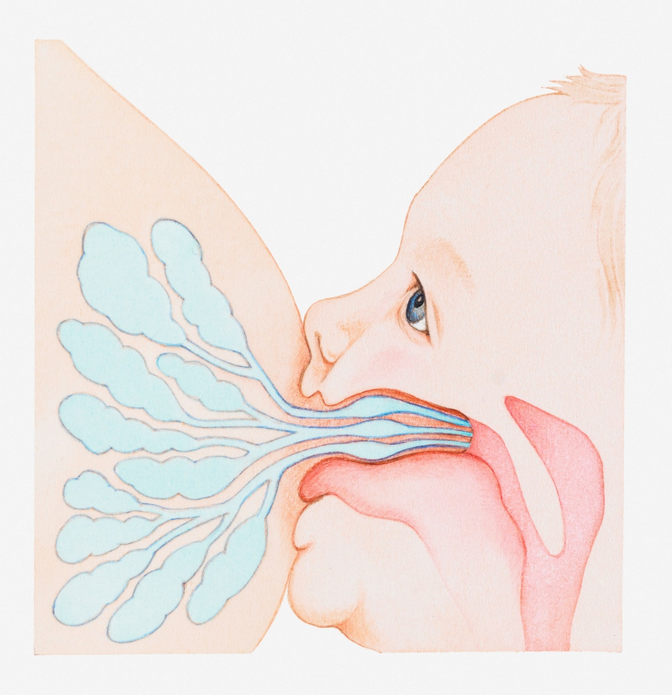
Notes:
This is a sketch of a baby latched onto the breast
You can see that the tip of the nipple is in the back of the baby’s mouth, at the level of the soft palate. This is the region where you have the uvula hanging down in the back of your throat. By having the nipple way back in the mouth, the nipple won’t get trapped between the tongue and the hard palate. When that happens the nipple feels pain and becomes cracked and sore.
You can see in this picture how the baby’s tongue sticks out past the lower lip. The tongue helps to keep the nipple deep into the mouth, and also helps to sweeps milk into the mouth.
The baby’s nose is right up against the breast, because the baby is kept close to the breast.

Slide 42
Keys to Comfortable and A-traumatic Latch
Keep baby close
Baby is aligned properly
  nose, bellybutton, knees
  Facing Mom
Mouth is wide open
Mom’s body is well supported
  Pillow in mom’s lap.
Notes:
Keys to Comfortable and Atraumatic Latch-
Lets first talk about what happens when you eat an apple. When you bring the apple to your mouth, your tendency is to have your head facing forward and in a neutral position, without looking up or down. If you try to take a bite when looking up or down, or with your head turned to one side or another, it can be hard to open wide, take a big bite while at the same time feeling that you won’t drop the bite of apple. In addition, you might feel a risk of choking when swallowing.
The same is true for the baby. The baby won’t latch deeply onto the breast unless he feels safe, but being in a neutral, relaxed position, which allows him to open his mouth wide and take the breast tissue deeply into his mouth. The keys to this comfort include:
Keep baby close to mother’s body
Baby should be aligned properly-
Check to see that the baby’s nose, bellybutton and knees are all in one line. Alternatively, check to see that the shoulder, ear and hip are all in one line
The baby should be facing mom
The baby’s mouth should be wide open
Mom’s body needs to be well supported, with back and leg support
She might need a foot stool to sit lean back, or to keep a pillow in her lap
A pillow in mom’s lap will bring the baby up, so that the baby can be closer to the breast. Once babies are older, such as 6 months or older, the baby can sit in mom’s lap to nurse, and she may not want to use a pillow any longer.

Slide 43


Slide 44
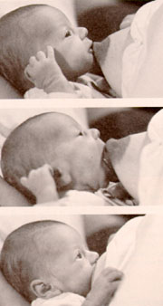

Slide 45
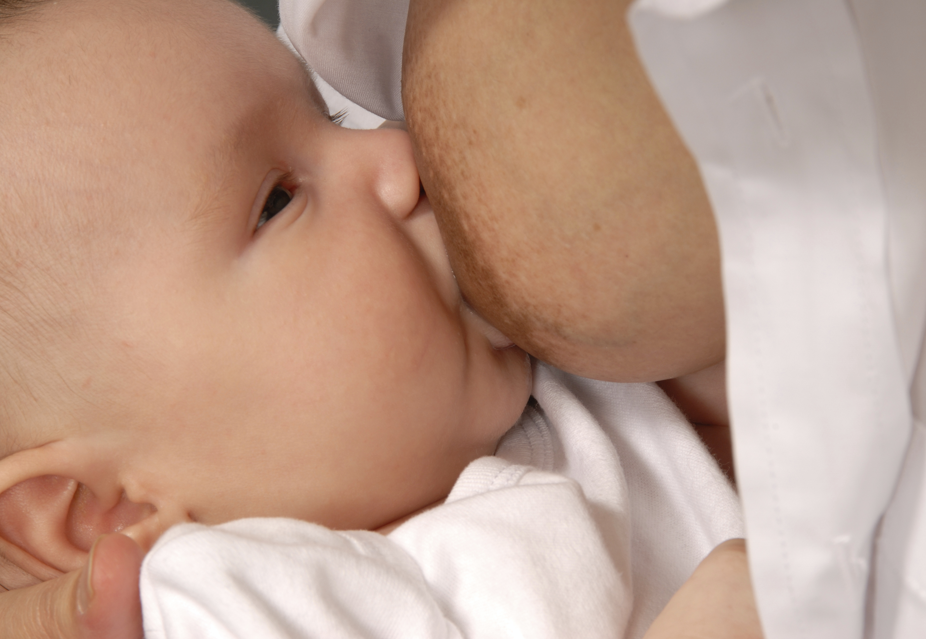
Good Latch?
Notes:
The next several slides show different latches, and I will ask you to tell me if this appears to be a good latch, or a problematic latch.
This latch looks good. The baby is close to the breast with a nice wide-open mouth. Nose is close to the breast

Slide 46

Good Latch?
Notes:
This latch is not ideal
The baby is further from the breast.
The mouth is not wide open, and the baby is not latched on deeply

Slide 47
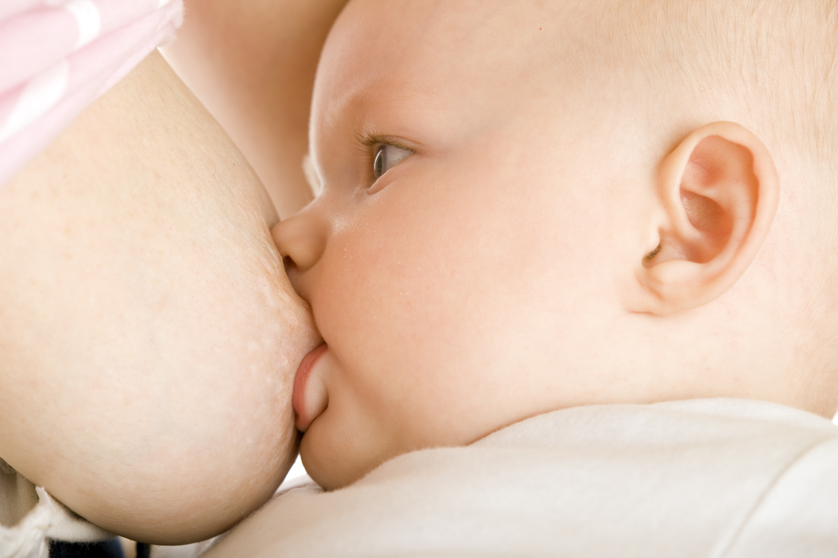
Good Latch?
Notes:
This latch appears to be problematic
The upper lip is tucked down, and needs to be flipped out, more relaxed.

Slide 48

Good Latch?
Notes:
This is a good latch
The baby has a nice wide, relaxed mouth, and appears to be deeply latched

Slide 49
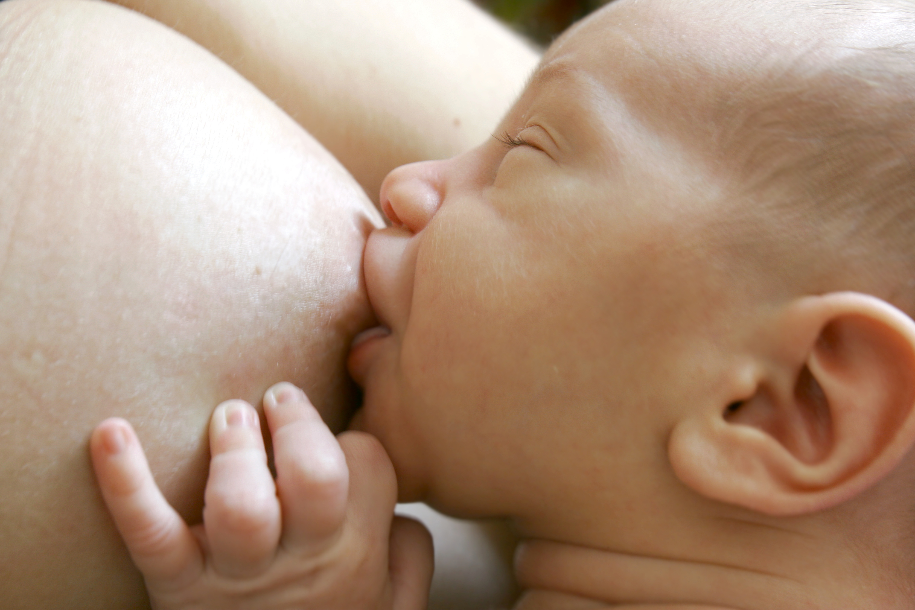
Good Latch?
Notes:
This latch is not ideal
The baby is not deeply latched to the breast. The lips are splayed nicely, but the mouth needs to be wider open, and the baby needs to be held closer, for a deeper latch.

Slide 50

Engorgement
Days 3-5 pp
Increased blood flow
Edema
Difficult to latch
Freq feeding is preventive
Notes:
Engorgement
Days 3-5 postpartum
Engorgement does not happen for everyone. IT is more common with the first baby. IT occurs when the body is bringing more fluid to the breast to increase milk production, around days 3-5 postpartum.
Increased blood flow
Engorgement is not the same as having excess milk in the breasts. Engorgement in the first week postpartum is due to increased blood flow to the breast, in order to start the process of making milk.
Edema
An engorged breast is often swollen with edema, much like a swollen ankle. There is fluid in the tissues around the ducts and milk producing cells.
The next slide shows a picture of where edema occurs
(go to next slide)

Slide 51
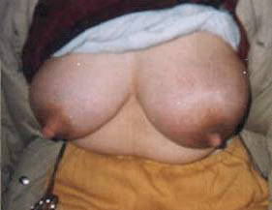

Slide 52
Underlying Problem | Management Strategy
Infant movement limitations due to torticollis, fractured clavicle, etc | Work on positioning
Prematurity/Low tone/sleepiness | Limit time at breast, pump to maintain supply, supplement infant
Broad flat nipples | Roll out or suction out nipples before latch, soften areola
Overactive letdown | Change positioning, reduce milk volume
Infant disinterest due to low flow | Supplement with a feeding tube at the breast
Oral defensiveness | Bottle and finger feeding, speech eval
Tight lingual frenulum | Clip the tongue tie
Oromotor dysfunction | Speech eval
Latch refusal | Infant-led latch
Notes:
This chart demonstrates typical management strategies that lactation consultants use for certain problems that cause traumatic nipple pain.
You don’t need to go over these in detail, but perhaps explain a few problems and solutions very briefly.
The goal of this slide is for the trainer to demonstrate to trainees that there are more advanced issues that lactation consultants deal with, which are beyond the scope of this training course.

Slide 53
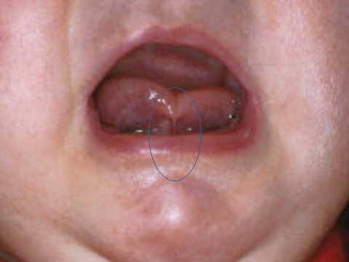
Notes:
Here is another example of an infant tongue tie. You can see that the tip of the tongue is tethered down, causing the tip to appear heart-shaped. This heart-shaped tongue tip is a tell-tale sign of a tongue-tie.
(click a second time and the circle appears)

Slide 54
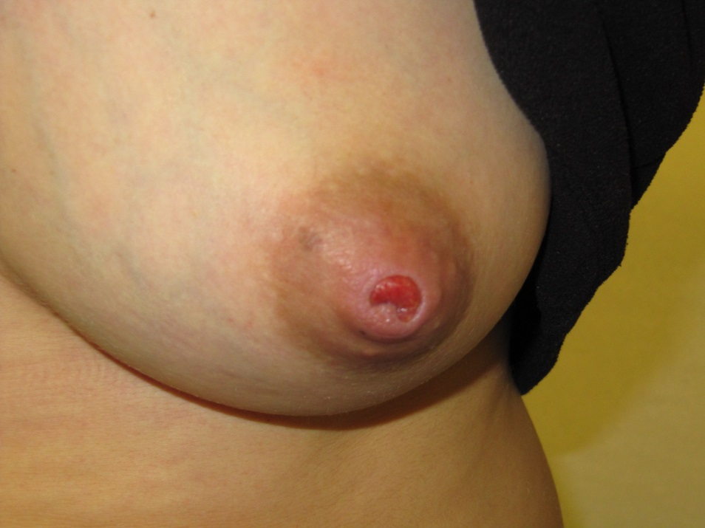
Cracked Nipple Treatment
Moist Wound healing
  Don’t let nipple stick!!
    Antibacterial ointment
    Nonstick pad
Decrease trauma
  improve latch!!
  Check for pump trauma
  Teach how to break seal
  Avoid prolonged nonnutritive sucking
Start with less sore nipple first
Hands on pumping if needed
Notes:
Cracked Nipple Treatment
Moist Wound healing
Don’t let nipple stick!!
Apply an antibacterial ointment, such as Bacitracin or mupirocin ointment. After putting on the ointment, cover the nipples with a nonstick pad, such as those made by Telfa or Curad. Some of the pharmacy chains have their own brands of nonstick pads. IF the nipples are sticking to breast pads/bras, the nipples are repeatedly damaged every time they are uncovered.
It is important to make sure that the baby can latch deeply to avoid nipple trauma. This means trying to decrease the edema to decrease trauma- improve latch!!
Treat underlying skin pathology
If the mother has a history of psoriasis or eczema, or another form of skin disease, she should be seen by her physician to determine if her sore nipples could be related to her skin disease.
Treat deep breast infection
IF women have deep penetrating breast pain, and their breasts are tender, it is important to have the mom seen by a lactation specialist to determine if she needs oral antibiotics. IF she does not have deep breast tenderness or pain, the nipples can just be treated topically with antibacterial ointment as above.

Slide 55
Conclusions
Mothers with red flags for insufficient breast development need close monitoring postpartum for infant weight gain.
The main reason for nipple pain postpartum is trauma from latch and positioning.
Families with a non-latching baby need lactation consultation. They can latch later.

