Slide 1
Low Milk Supply
Anne Eglash MD
Clinical Professor
Dept of Family Medicine
University of Wisconsin School of Medicine and Public Health

Slide 2
Objectives
Identify 3 prenatal health problems that may contribute to a low supply.
Identify 4 major steps in establishing a healthy milk supply.
Explain how to support a sleepy baby and preserve’s mom’s milk supply.
Explain 2 common preventable reasons for a low milk supply.
Recognize 3 common pitfalls after 4 months pp that can increase the risk of decreasing milk supply.

Slide 3
Low Milk Supply
Insufficient breast development
Obesity, PCOS, DM, HBP, Infertility
Milk never came in postpartum
Milk came in but mom lost her milk
MOST COMMON CAUSE
PP bleed, morbid obesity, retained placenta
Lack of nipple stimulation
Lack of breast emptying
Maternal illness, medication
Notes:
This is a breakdown of causes of Low Milk Supply- we will talk more in detail in the following slides.
Low milk supply happens either because
1. there is insufficient breast development during pregnancy, or
2. something happened after birth that caused the milk to not come in, or
3. The milk came in just fine, but mom lost her supply
We will now go into each of these problems in detail

Slide 4
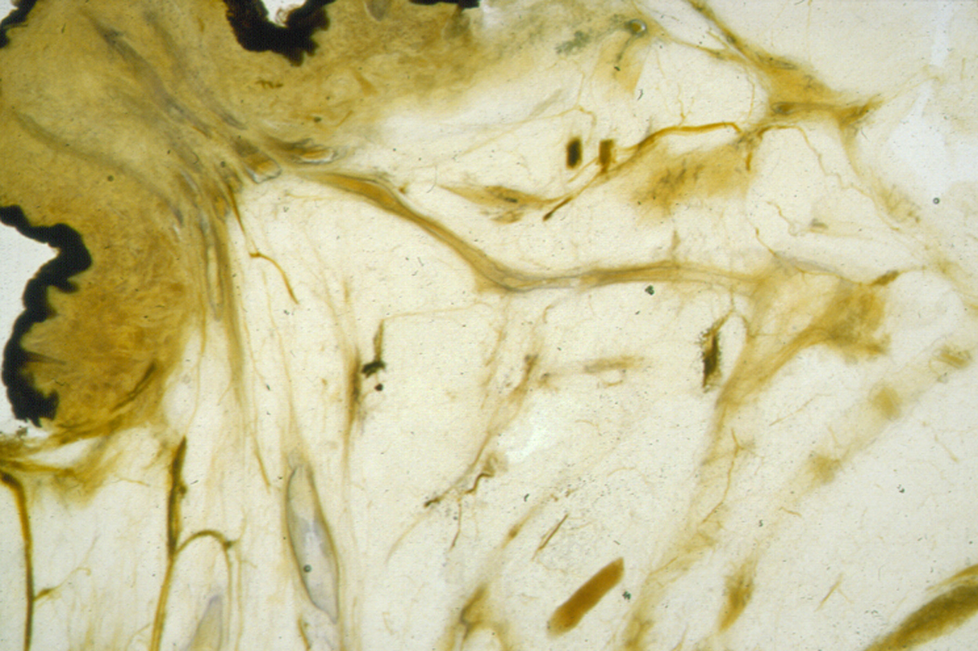
Breast Anatomy and Physiology

Slide 5
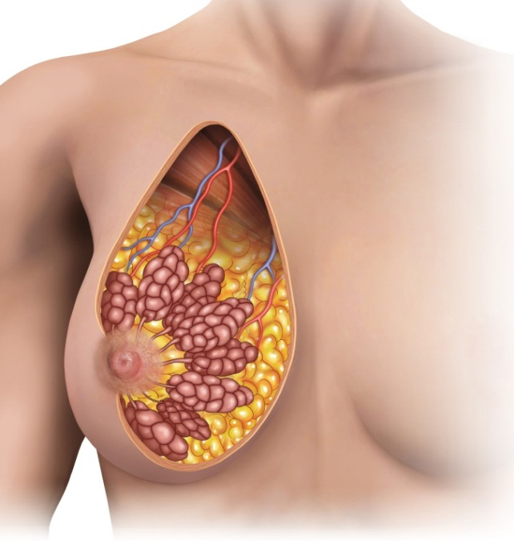
alveolus
lobule
fat
Lactiferous duct
Notes:
This is a picture of breast anatomy (note that the words come one by one with each click)
Alveolus- each individual grape-like structure is called an alveolus. They are clustered together like grapes on a vine, and share ducts. Each alveolus is lined with cells that make milk. The milk is expressed from each cell into the center of each alveolus, as we will see later.
Lobule- a lobule is a cluster of alveoli, which share common ducts.
Fat- Fat surrounds the glandular tissues that make milk
Lactiferous duct- Breastmilk travels from the alveoli down these ducts, eventually reaching the pores of the nipples.

Slide 6
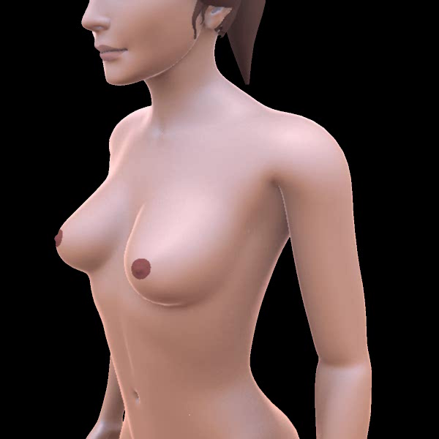
Notes:
Mouse over the bottom of this picture, to show this animation.
First you will notice the extensive lymphatic tissue around the breast.
The animation then focuses on a side view of an alveolus. You can see how the alveolus is lined with milk producing cells. The milk gathers in the center of the alveolus. The alveolus contracts and forces milk through the ducts and then out of the breast.

Slide 7

Prenatal Breast Development

Slide 8
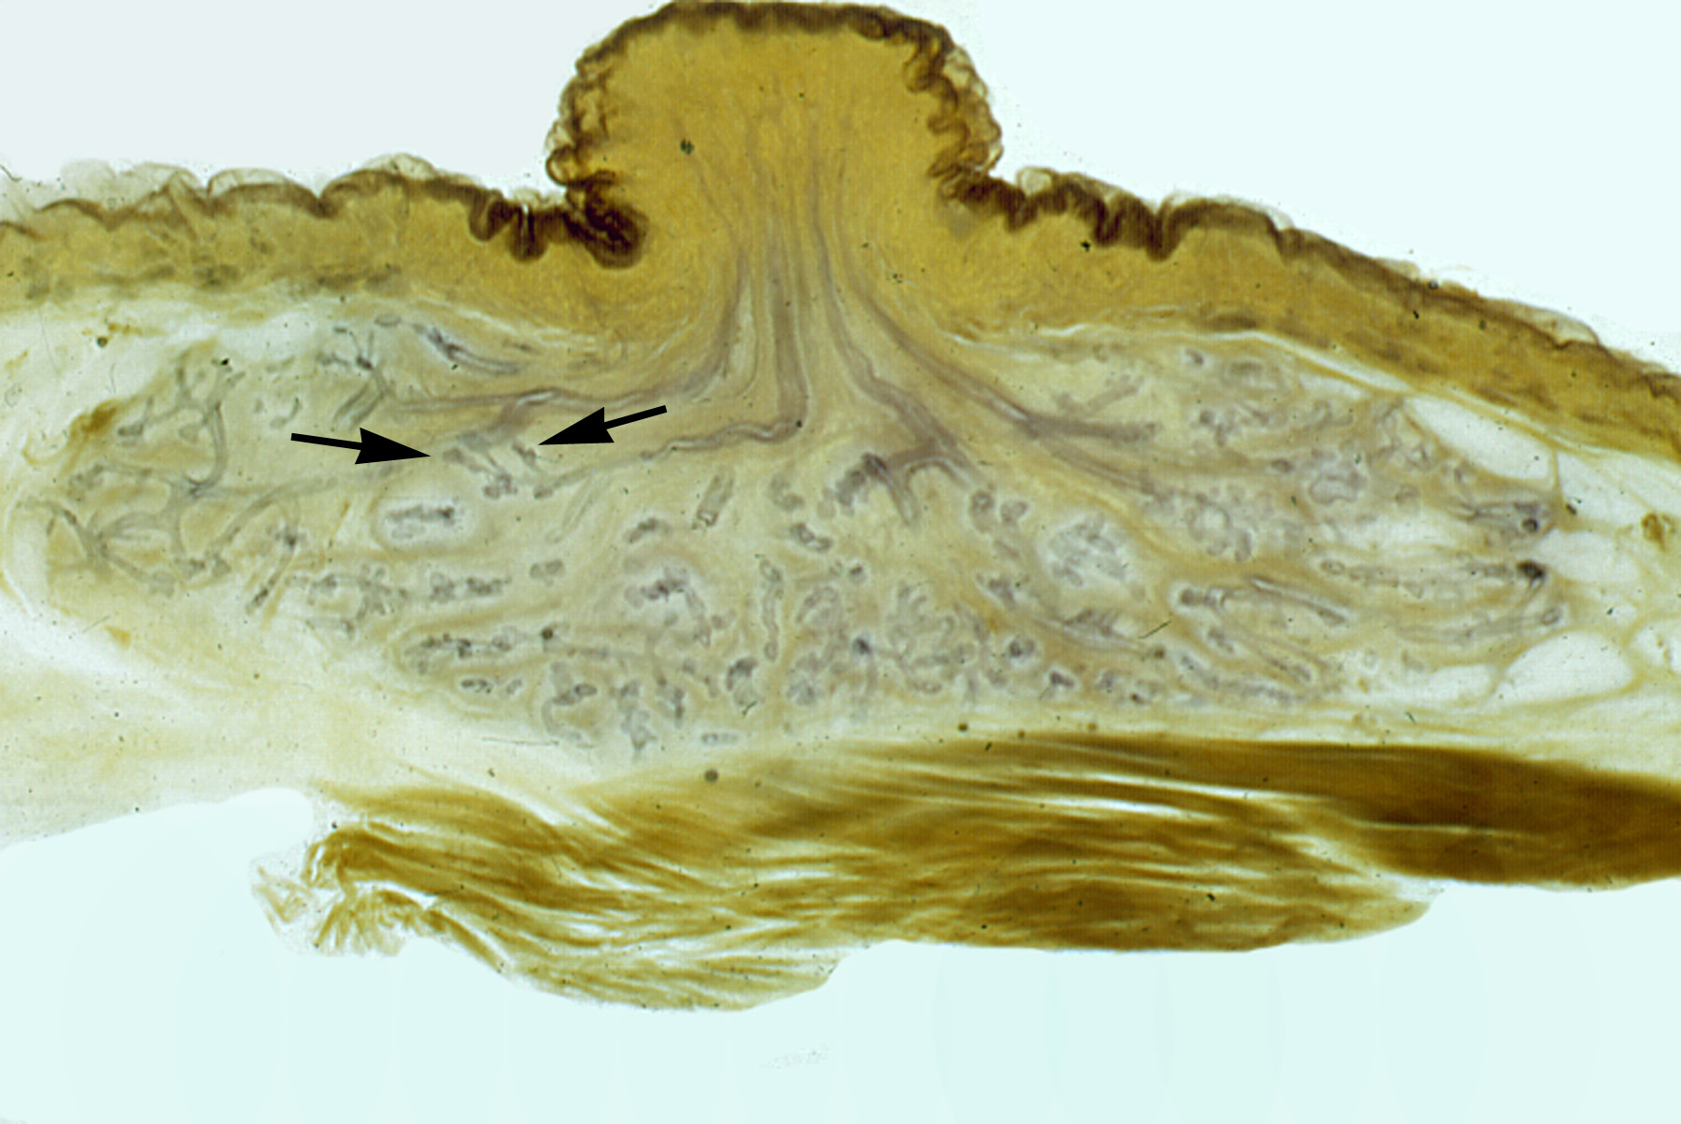

Slide 9
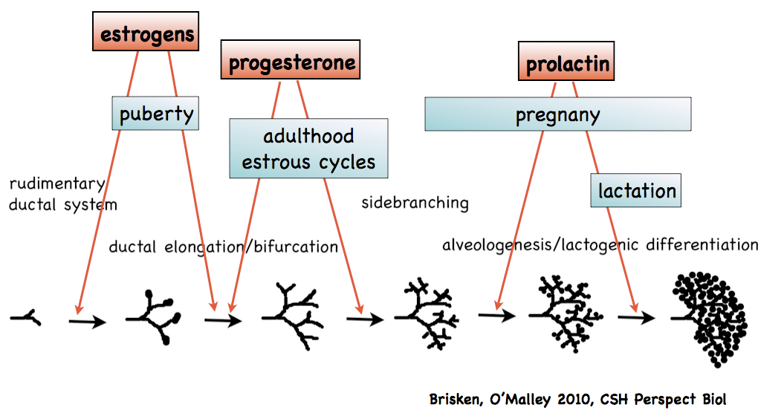

Slide 10

Placental Hormones Affecting Breast Growth
Estrogen
Parathyroid hormone
related protein
Progesterone
Human Placental Lactogen
Insulin-like Growth Factor
Prolactin
Fibroblast Growth Factor
Growth Hormone
Notes:
Placental Hormones Affecting Breast Growth
Once a woman becomes pregnant, she grows a placenta in her uterus. The placenta excretes many hormones which all play a role in making sure that the breasts grow and develop in order to make milk.
You can see breast development during pregnancy is complicated with many hormones involved.

Slide 11
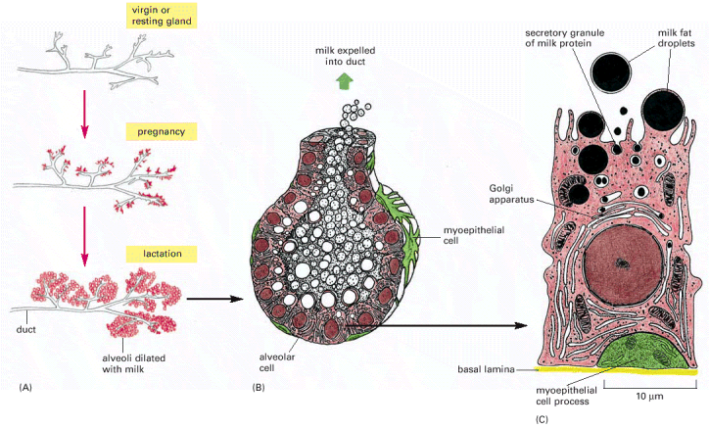
Notes:
Here are more sketches of glandular tissue.
You can see on the left how the alveoli grow during pregnancy, and the breast becomes very lush and full by the time lactation begins after birth.
The center picture is a sketch of an alveolus. You can see there are milk producing cells along the sides.
On the outside of the alveolus is a green cell called a myoepithelial cell. This cell has long arms. There are many of them on the outside of the alveolus. The cells reach out and squeeze the alveolus when oxytocin surges, allowing the entire alveolus to contract and expel milk into the ducts.
The sketch on the R is a lactocyte, or a milk producing cell. Milk is made inside the cell.

Slide 12





Slide 14
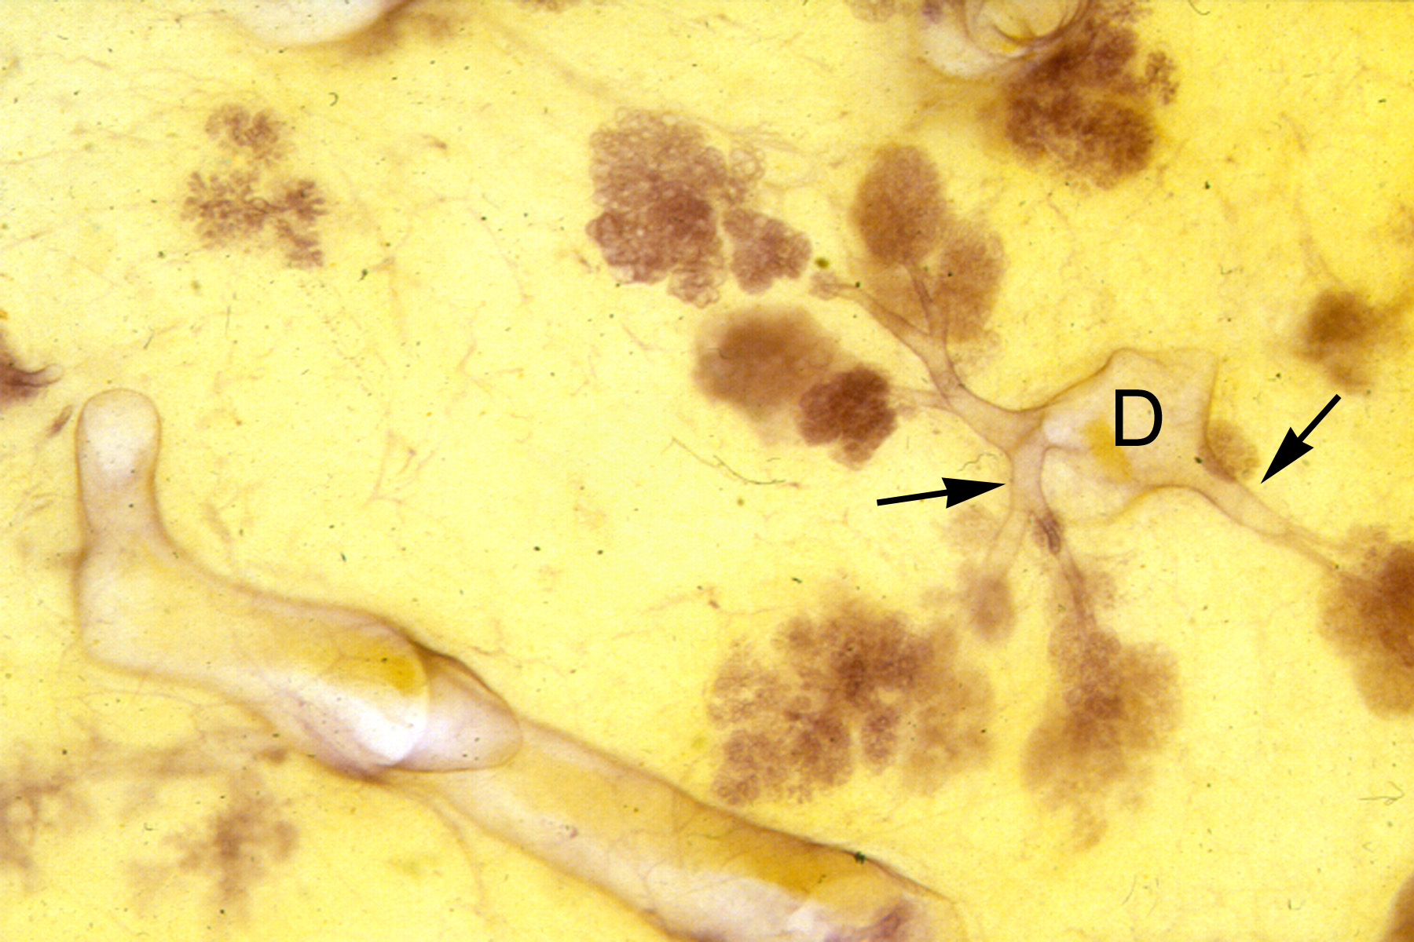

Slide 15
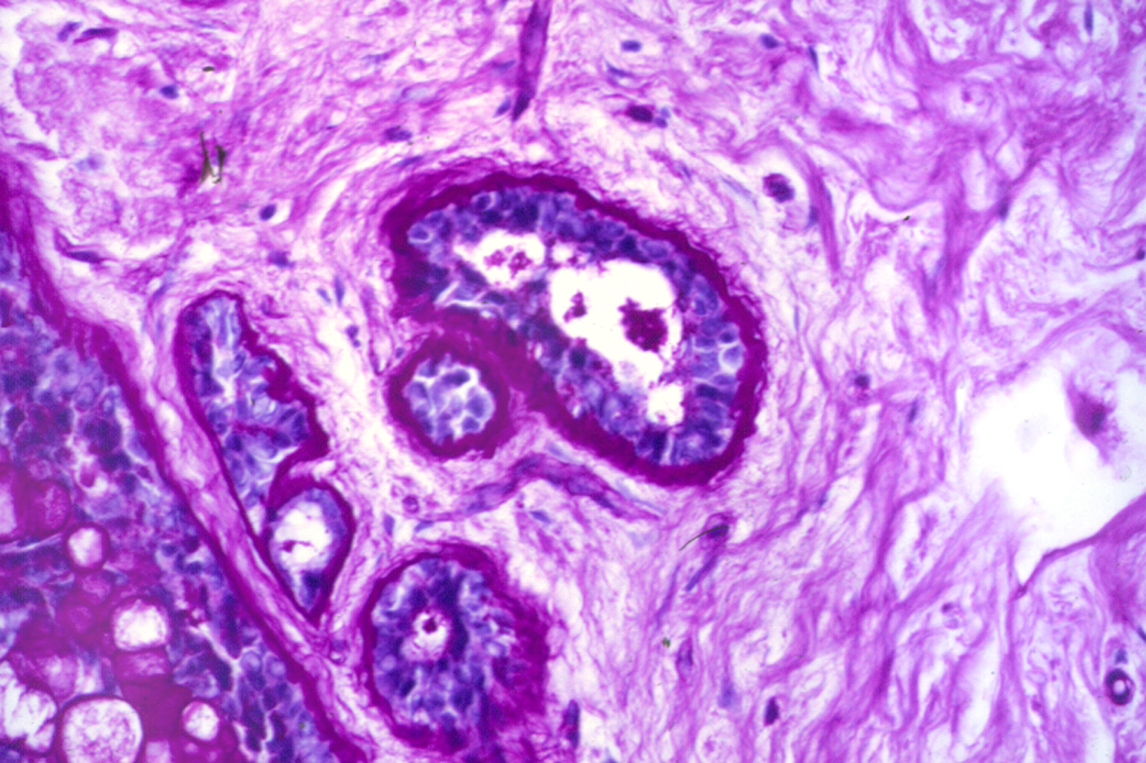

Slide 16
Lactogenesis
In Pregnancy
Ache and grow
Increase in protein, lactose, Ig,
Leaky
differentiate

Slide 17
Little-No Breast Changes in Pregnancy
Little Breast Change
Insufficient Glandular Tissue
Congenital
Acquired
(ie surgery, radiation)
Hormonal Interruption
PCOS, Obesity, High Androgens

Slide 18
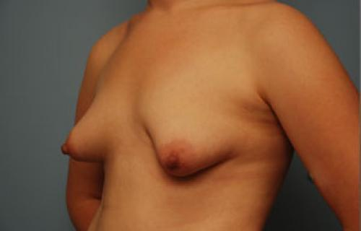
Insufficient Glandular Tissue

Slide 19
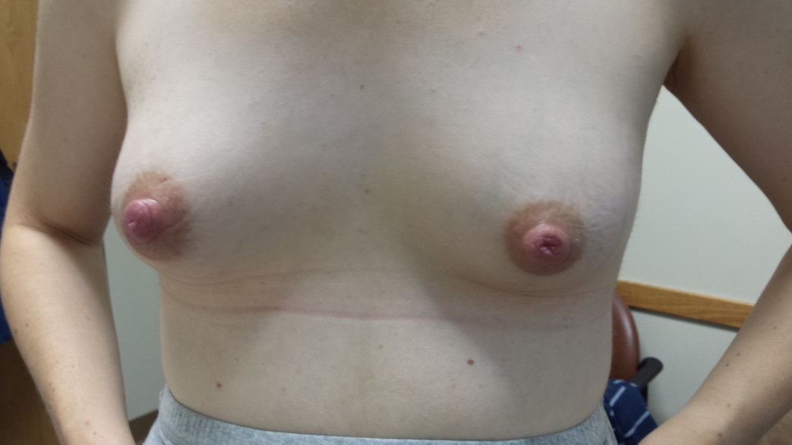
Insufficient Glandular Tissue
Small amount of glandular tissue
Trauma to the breast tissue as a child
Breast Surgery;reduction, lumpectomy
Breast radiation

Slide 20

Normal Appearing Breasts but Lack of Full Growth
High Androgen States
  Obesity
  Polycystic Ovarian Syndrome
  Gestational Diabetes
  Pre-eclampsia

Slide 21
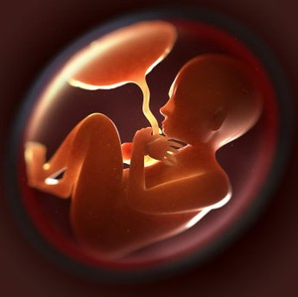
others
progest
estrogen
Androgens

Slide 22
Lack of Sufficient Breast Development
Important to identify early pp
  If little growth in preg, follow closely.
Hard to diagnose during pregnancy.
  No good prospective studies.

Slide 23
Structural vs Hormonal Causes
IGT
  Hormones are intact
  Engorgement happens
  Breasts feel full at times
  Volumes are small
Hormonal
  Hormones not intact
  Lack of engorgement
  Breasts do not feel full
  Volumes are small

Slide 24

You see a mother for her concern about lack of breast development during pregnancy.
She never noticed any breast aching or growth.
She heard that this might be a problem with nursing.
What Questions Will You Ask Her?

Slide 25
Case of Insufficient Breast Development
Infertility?
PCOS?
H/o morbid obesity?
H/o irregular menses?
H/o breast surgery?
H/o breast or chest irradiation?
Diabetes- type 2 or gestational?
H/o chest trauma as a child?

Slide 26
Placenta is delivered
Placental hormones diminish
Pituitary & Breast tissue seize control
Notes:
Once the placenta is delivered, the hormones from the placenta diminish, and control of the breast tissue switches to:
1. Prolactin & oxytocin in the pituitary gland
2. Local hormone and chemical signals in the breast

Slide 27
Progesterone
High progesterone level from placenta blocks PRL receptors
  prevents milk production
  PRL levels are already high
Progesterone level gradually drop pp
  PRL receptors available to stimulate milk production

Slide 28
Lactogenesis After Birth
Placenta delivered, hormones fall
Colostrum
High in WBCs, betacarotene, protein, vits, Ig (pus)
Gradual increase in fluid, blood flow, oxygen, glucose, breasts become fuller

Slide 29
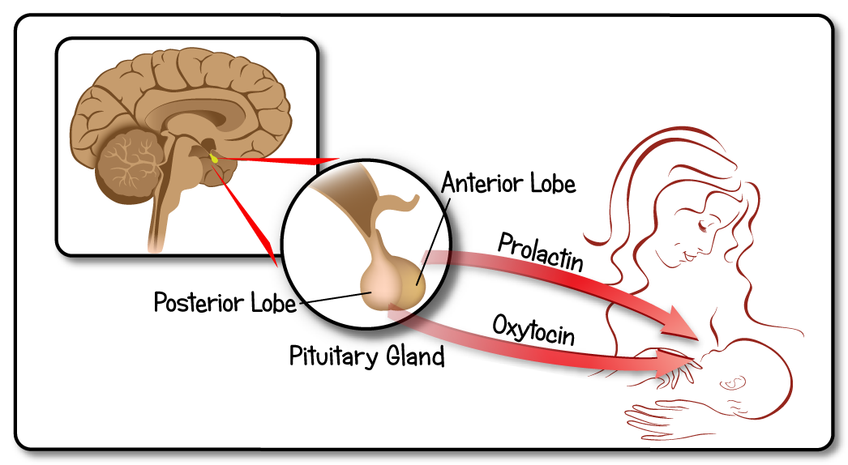
The Pituitary Gland Takes Over
Notes:
The pituitary glands dangles under the brain tissue, behind and between the eyes. It has an anterior lobe and a posterior lobe.
Prolactin comes from the anterior lobe of the pituitary gland
Oxytocin comes from the posterior lobe of the pituitary gland

Slide 30
Prolactin
Released from anterior pituitary
Stimulates breasts to produce milk.
Requires nipple stimulation.
Prolactin level ≠ Amount of milk
Increasing prolactin won’t increase milk without breast emptying
Notes:
Prolactin:
Prolactin is released from the anterior pituitary gland.
Prolactin is the hormone that tells the breast to make milk, much like how the boss of a factory tells the assembly line to keep moving.
The prolactin level rises in response to nipple stimulation. Also, mom has to be able to feel the stimulation for the prolactin level to rise. This is very important. If the nipples are not stimulated enough, the prolactin level will go down. So if the baby is not nursing enough, or if the nipples are numb, or if a nipple shield is put over the nipple and prevents nipple sensation, the prolactin level won’t rise.
The level of prolactin in the blood does not predict how much milk the mother is making. This means that if we run a prolactin level, we cannot tell by that level how much milk the mother will make.
Increasing the prolactin level by giving herbs or medications will not make mother produce more milk if she is not nursing or pumping. In other words, if the mother is not using the milk, her body won’t keep making more.

Slide 31
Prolactin
Blunted by:
  Medications and drugs
    Tobacco
    Bupropion (wellbutrin)
    Pseudoephedrine (sudafed)
    Estrogen
    Certain antipsychotics
  Nipple insensitivity
  Pituitary trauma
  Insufficient demand
  Hormonal blockage
    Testosterone secreting ovarian cyst
    Estrogen
Notes:
Prolactin secretion from the pituitary can be affected by many substances and events. These issues can lead to insufficient milk supply:
Medications and drugs-
Tobacco- women who smoke make less milk due to having a lower prolactin level
Bupropion (wellbutrin)- this is an antidepressant which can lower prolactin
Pseudoephedrine, AKA sudafed, is a popular decongestant for stuffy noses. It can reduce the milk supply by 25%. It is possible that at least part of its effect is by reducing the prolactin level
Estrogen – estrogen is known to reduce the prolactin level. Estrogen given at any time during lactation can reduce the milk supply
Nipple insensitivity-
If a woman does not have adequate nipple sensitivity her prolactin level may not rise. Common causes would be breast surgery, esp breast reduction.
Pituitary trauma-
Because prolactin comes from the pituitary gland, any injury to the pituitary gland can lead to insufficient milk. This is not a common problem, but can rarely occur in cases of excessive postpartum hemorrhage. A major blood loss can lead to low blood pressure, causing lack of blood flow to the pituitary gland. If this happens, the pituitary can suffer injury to the cells that make prolactin.
Insufficient demand-
If the nipples are not stimulated, the prolactin level won’t rise.
Hormonal blockage-
Testosterone secreting ovarian cyst- If an ovary has a cyst that secretes testosterone, the testosterone will decrease the prolactin level
Estrogen- The estrogen level rises with pregnancy. If a woman becomes pregnant while nursing, she will notice that a drop in her milk supply

Slide 32
Oxytocin
Released by posterior pituitary
Many sensory pathways-visual, auditory, olfactory, tactile
Stimulates milk ejection
Several let-downs occur during a nursing session
Tingly/tight sensation
Notes:
Oxytocin-
Oxytocin is released by posterior pituitary thru multiple sensory pathways-visual, auditory, olfactory, tactile, auditory. This means that oxytocin release from the pituitary is much easier than prolactin release. Oxytocin can be released if mom sees the baby, hears the baby, touches, smells or thinks about the baby.
Oxytocin causes milk ejection from alveoli and smaller milk ducts into the larger lactiferous ducts. Each milk ejection is also termed a ‘let-down’. Mom will notice a series of swallows by the baby with each let-down. If she is pumping, she will see several sprays of milk for a duration of time, and then the sprays will lessen, until the next ‘let down’
Several let-downs occur during a nursing or pumping session. The first letdown has the greatest amount of milk.
The let-down feels like a tight, tingly sensation in the breast.
First-time moms often don’t feel their let-down sensation for several months. But they can observe the letdown while pumping, or by watching the baby’s swallowing patterns during nursing.

Slide 33
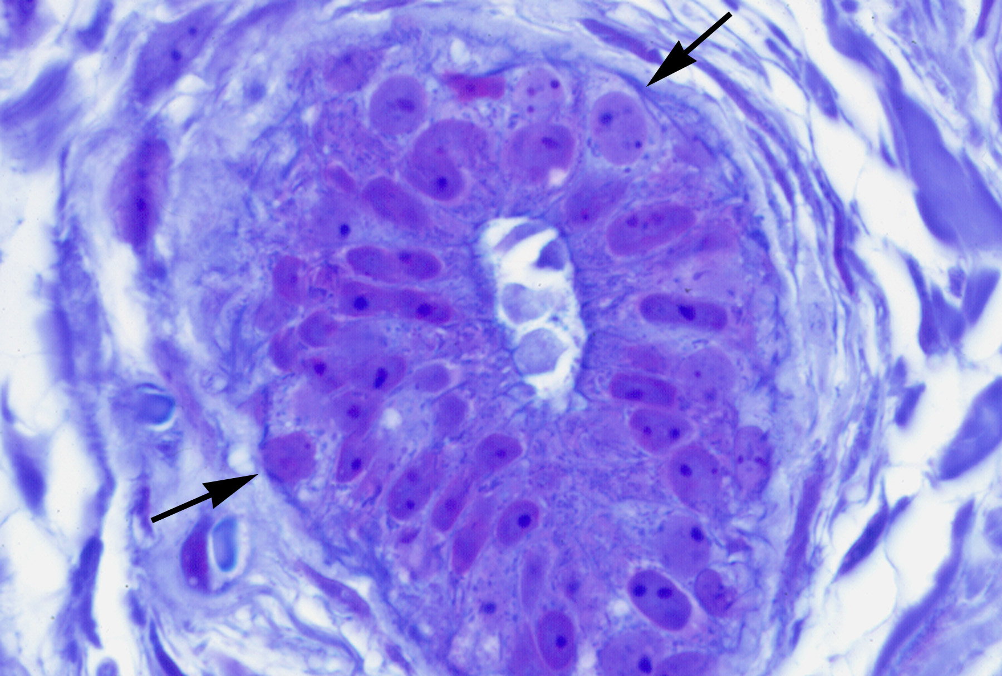

Slide 34

Getting off to a Great Start
The Best Way to Establish A Healthy Milk Supply

Slide 35
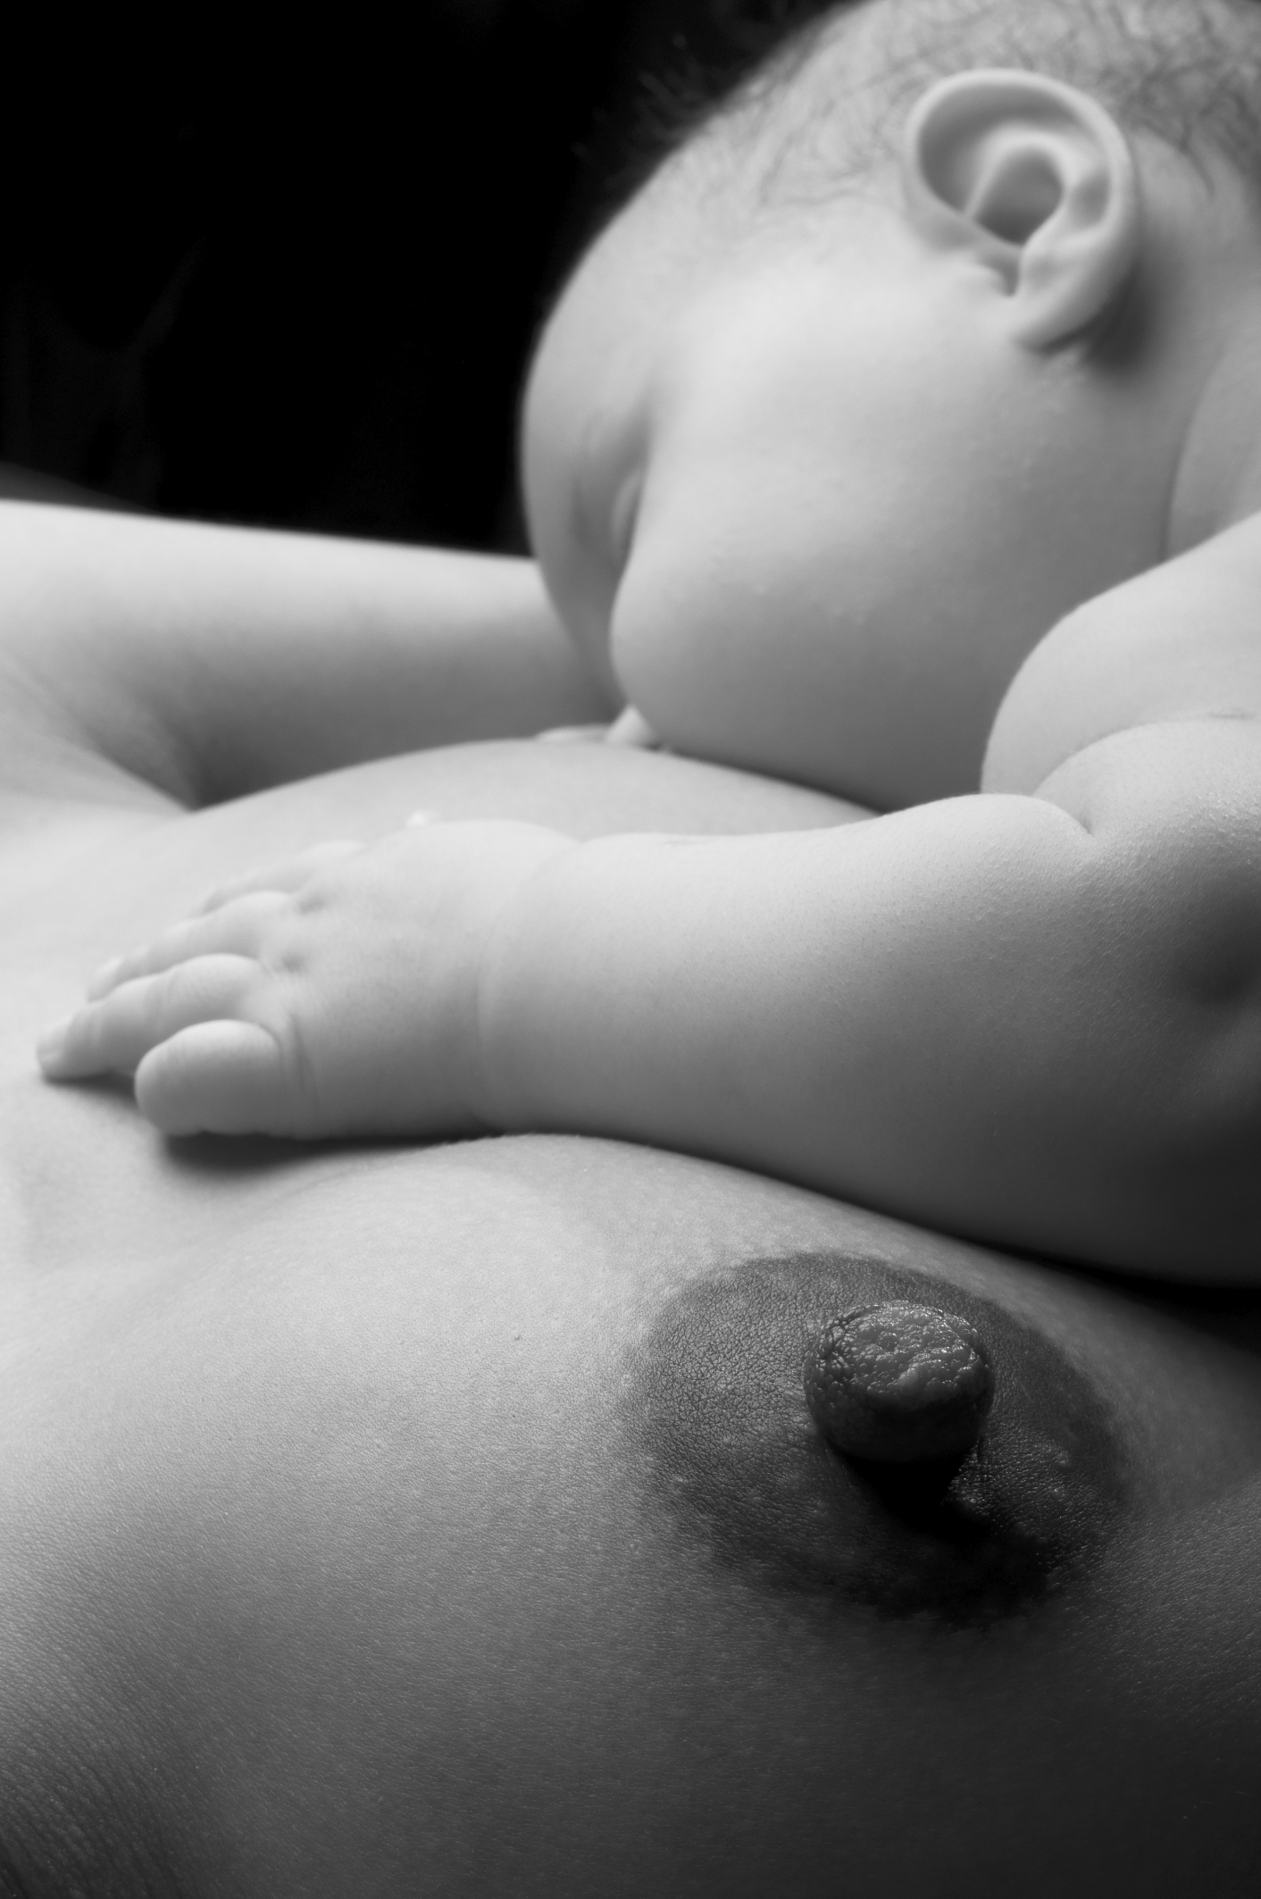

Slide 36
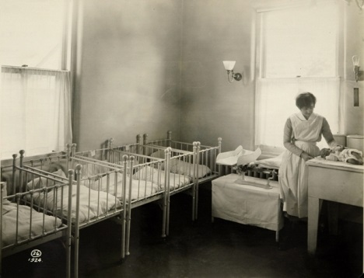
Breastfeeding Early Postpartum
Limit pain to prevent newborn sleepiness
Skin-to-skin soon and often
  Delay unnecessary interventions
Rooming-in
Breastfeeding education for family
No anti-lactation meds

Slide 37
Early Skin-to-Skin Contact
Increased:
  Breastfeeding duration
  Thermoregulation
  Blood glucose
Decreased Infant crying
Increased maternal affectionate love/touch
Notes:
Early Skin-to-Skin
We know from several studies that when babies are put skin-skin early, they have increased:
Breastfeeding duration – the baby is likely to nurse longer than a baby who did not have a chance to be skin-skin with mom in the hospital
Thermoregulation – mom is the ‘warmer’, and she is able to keep the baby warm. The baby does not need to be separated into a separate warmer
Blood glucose –the baby’s blood sugar is much more stable. This is probably due to the fact that the baby is more likely to nurse early, longer and more often. The baby is also warmer, which helps to prevent a drop in blood sugar
Infant crying – The baby does not cry as much, as the baby feels safer, is more comfortable and feeding more often.
Increased maternal affectionate love/touch Early skin-to-skin helps to change mom’s hormones too, which have an effect on her sense of affection, bonding, and love for her baby

Slide 38
Skin-to-Skin and Self-Led Latch
Awakens infant feeding reflex
Organizes route to feeding
  Search->feel->root
  Baby finds the nipple/areola and latches
Notes:
Skin-to-Skin and Self-Led Latch
Why does skin-to-skin increase breastfeeding frequency, and early nursing?
Skin-skin awakens the infant feeding reflex
Think about what happens when you hold a young baby against your chest, and the baby is awake. The baby will start to bob and peck at your chest with his mouth. You will then feel the baby shift his weight to one side, as if the baby is ‘flinging’ himself to one side.
The bobbing/pecking and flinging to one side make up the feeding reflex. These are movements that indicate that the baby is looking for the breast. Starting Chest-chest stimulates these reflexes to take off.
Organizes route to feeding
If the baby is allowed to move to the side, the baby will use his mouth and cheeks to ‘root’, by moving his face from side to side, using the cheeks to root to find the nipple.
Once the baby finds the nipple the baby will try to latch.

Slide 39
First Few Days of Breastfeeding
Feedings 10-12 times a day
  All sucking at the breast.
Frequent, effective feeding crucial
Focus on baby, not visitors
No pacifiers or supplements unless medically indicated
Cracked, bleeding nipples not normal
Notes:
First Few Days of Breastfeeding
Infants need to feed at least 10-12 times a day
All sucking needs should happen at the breast. If the baby is given a pacifier, the baby might just sleep his hunger away and not nurse
Frequent, effective feeding crucial to securing a good early milk supply
As previously stated, the more often mom is nursing, the faster her milk will come in. This means that the baby stays strong with less postpartum weight loss.
Teach mom to focus on baby, not visitors!
This allows mom to identify the baby’s early feeding cues
No pacifiers or supplements unless medically indicated
The baby should not be given pacifiers, as we discussed, since the baby may not eat as often. It may also lead the baby to look for a different sort of nipple to latch on to, causing infant frustration. This is not really nipple confusion, but rather nipple preference.
Cracked, bleeding nipples not normal
If the nipples are cracked and bleeding, latch is problematic, and this needs to be addressed right away by a lactation specialist or other knowledgeable professional. If not, mom won’t nurse as often, and the pain will inhibit her let-down reflex, leading to a lower milk supply

Slide 40
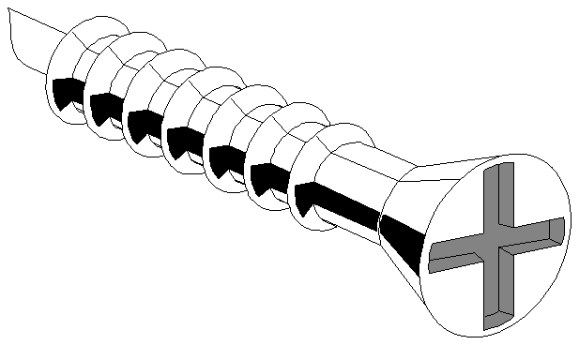
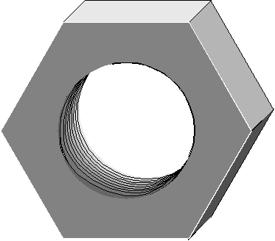
Breast Emptying
Pituitary Hormones

Slide 41
Frequent Feeding
Complete Emptying
Engorgement
Decreased Frequency
Poor milk transfer
More Milk
Less Milk
Notes:
More Milk (Up Arrow)
More frequent feeding and complete emptying of the breasts will help to ensure a sufficient milk supply
Less Milk (Down Arrow)
The principle here is that when the breasts are making milk, but the milk is not removed, the cells that make the milk will slow down on milk production
Engorgement is a common problems that can lead to a decrease of milk supply, especially if it is prolonged
Leaving the breasts full by not nursing the baby often will also lead to loss of milk.
In addition, if the baby is not transferring milk well, the breasts will remain full, which also will lead to a decrease in supply.

Slide 42
Milk does not come in
Delay in lactation
Medication/hormones inhibiting lactation
Maternal illness, ie Sheehans
Retained Placental Fragments
Insufficient breast development

Slide 43
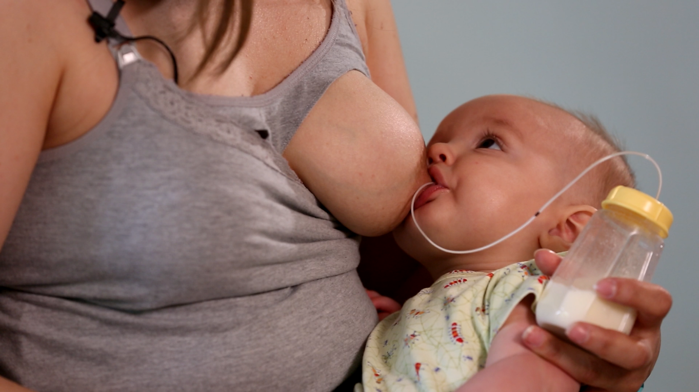
Dx of Delayed Lactation
Milk is not ‘in’ by day 2-3 for multip, 2-5 for primip
Breasts don’t feel fuller

Slide 44
Rates of Delay in Lactation
Dewey KG. Pediatrics. 2004;112:607-619
Suboptimal infant breastfeeding behavior among 280 breastfeeding dyads:
  Day 0 49%
  Day 3 22%
  Day 7 14%
Delayed lactogenesis
  22%
Excess wt loss > 10%
  12%
Notes:
Dewey KG, et al. Risk factors for suboptimal infant breastfeeding behavior, delayed onset of lactation, and excess neonatal weight loss. Pediatrics. 2003;112:607-619.
280 mothers
SIBB (suboptimal infant breastfeeding behavior)
Day 0 49%
Day 3 22%
Day 7 14%
Determine incidence of and risk factors for suboptimal infant bf behavior, delayed lactogenesis and excess neonatal weight loss among dyads in population w/ high educational levels and motivation to bf
IBFAT - Infant BF Assessment Tool - - includes ratings for arousal, rooting, time to latch and feed well and suckling effectiveness
Prevalence of SIBB was 49% at day 0, 22% at day 3 and 14% at day 7
SIBB was signficiantly associated w/ primiparity, c-section, flat or inverted nipples, infant status at birth, use of nonbreastmilk fluids in 1st 48 hrs, pacifier use at day 3, stage II labor > 1 hr, maternal bmi > 27 kg/m2, birth weight > 3600 g
All infants should be evaluated at 72-96 hr postpartum

Slide 45
Primipara
Long labor
BMI>27
C-Section
Supplementation
Causes for Delay in Lactation
Dewey KG. Pediatrics. 2003;112:607-619

Slide 46

Substances that Decrease Milk Volume
Bromocriptine, dostinex
Estrogen-containing OCPs
Depot Medroxyprogesterone
Decongestants
Bupropion
High dose SSRIs
Nicotine
Alcohol
Narcotics
Placenta(?)
Herbs
Certain anti-psychotics
High dose steroids

Slide 47
Retained Placenta
Few studies, mostly case reports
  Abdominal pregnancies with placenta left intact
  Placenta accreta
Lack of drop in progesterone
  Many cases of normal lactation and retained placenta
Diagnosis is difficult
  HCG high <1mo pp
  Early ultrasound hard to interpret
  Irregular bleeding may come late

Slide 48

Hypopituitarism
Sheehans syndrome
  Postpartum hemorrhage
Hypophysitis
  Chronic autoimmune illness
  30-70% of cases in women in late preg/postpartum
Traumatic Brain Injury
Notes:
Dr. Sheehan’s original group of patients with hypoprolactinemia may have had autoimmune hypophysitis

Slide 49
You are seeing a G1P1 mom on day 4.
She gave birth to a 38 week baby boy, birth weight 7 lb 1 oz.
She was told to supplement her baby because the baby is
13% below birth weight, and is acting very hungry.
Her breasts don’t feel full yet, despite nursing the baby every 2.5 hours day and night.
What questions help evaluate cause of her low supply?

Slide 50
Case of Little Milk by Day 4
Breast growth during pregnancy?
Breast surgery, radiation?
Gestational or type 2 DM?
PCOS or infertility?
Complications of Delivery
  Hemorrhage
  Pre-eclampsia
  Emergency surgery, ICU stay?
  Other maternal illness?
Medications postpartum?
Tobacco, alcohol, or illicit drug use?
Placenta ingestion?
Using a nipple shield?

Slide 51
Low Milk Suppy
Insufficient breast development
Obesity, PCOS, DM, HBP, Infertility
Milk never came in postpartum
Milk came in but mom lost her milk
MOST COMMON CAUSE
PP bleed, morbid obesity, retained placenta
Lack of nipple stimulation
Lack of breast emptying
Maternal illness, medication
Notes:
This is a breakdown of causes of Low Milk Supply- we will talk more in detail in the following slides.
Low milk supply happens either because
1. there is insufficient breast development during pregnancy, or
2. something happened after birth that caused the milk to not come in, or
3. The milk came in just fine, but mom lost her supply
We will now go into each of these problems in detail

Slide 52
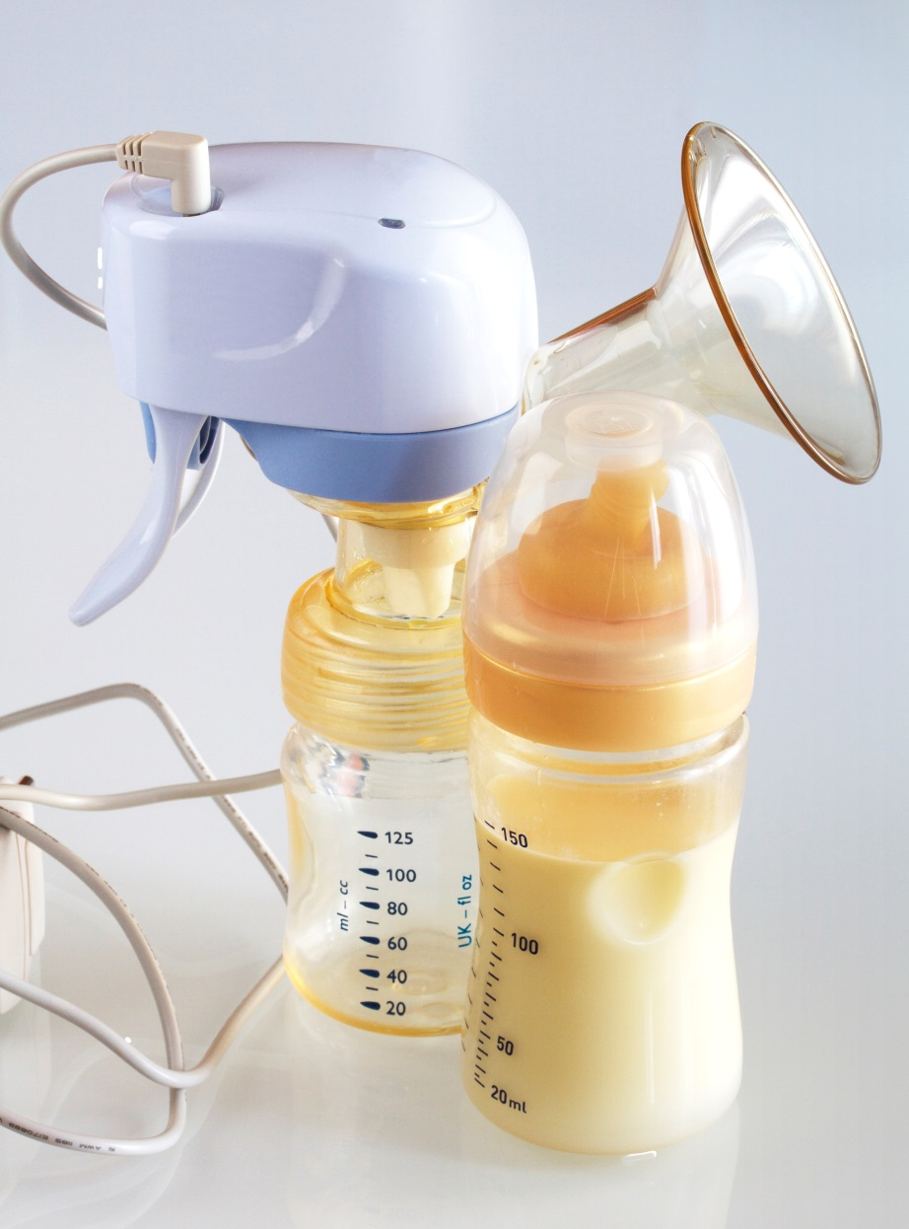
Lack of Nipple Stimulation
Insufficient prolactin level
  Infrequent feeding
  Nipple shield
  Decreased nipple sensation
  Reliance on pumping

Slide 53
Lack of Breast Emptying
Infrequent feeding
  Sore nipples
Nipple shield use
Insufficient milk transfer
  Weak, sleepy baby
  Premature infant
Long durations of not nursing over night
Inadequate let down

Slide 54
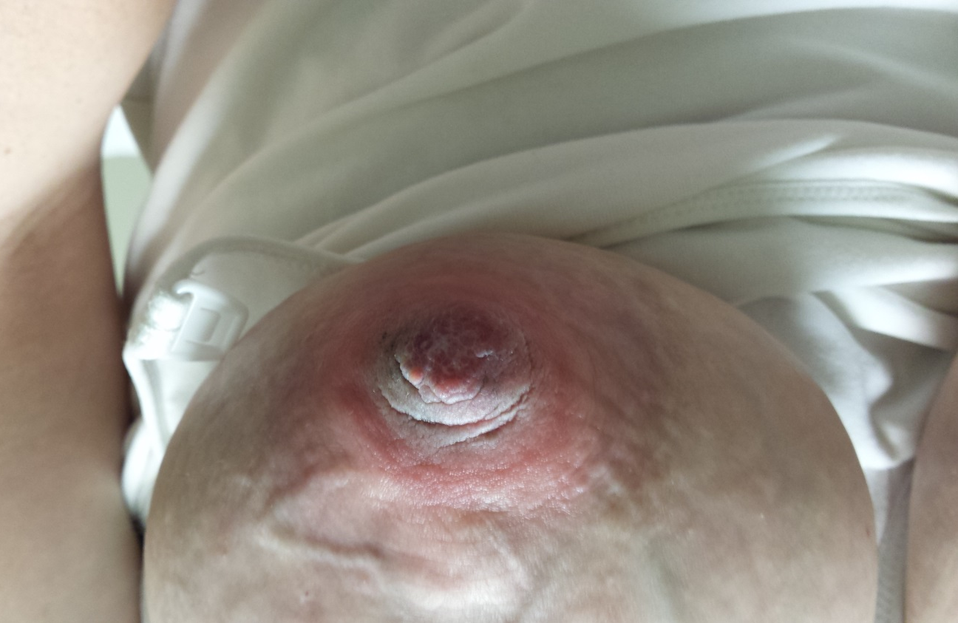
Maternal Health Issues and Loss of Milk Supply
Pregnancy
Medications
Mastitis/abscess
  Chronic breast pain
  Recurrent plugs
Thyroid disorder
Dehydration
Major surgery
Excessive weight loss

Slide 55

Substances that
Decrease Milk Volume
Bromocriptine, dostinex
Estrogen-containing OCPs
Depot Medroxyprogesterone
Decongestants
Bupropion
High dose SSRIs
Nicotine
Alcohol
Narcotics
Placenta(?)
Herbs
Certain anti-psychotics
High dose steroids

Slide 56
You are seeing a mother 3 weeks postpartum because of a low milk supply. She reports having a normal pregnancy, and normal vaginal delivery at term.
Her baby was born healthy, and nursed well after birth.
His birth weight was 8 lb 4 oz.
His discharge weight on day 2 was
7 lb 12 oz, and on day 3 was
7 lb 13 oz. He was then seen at 2 weeks of age, and his weight was
7 lb 14 oz.
Mom recalls feeling very engorged on day 3.
What questions would you ask?

Slide 57
Case of Insufficient Weight Gain at 3 Weeks
Prenatal
  Did your breasts grow during pregnancy?
  History of breast surgery?
Postpartum
  Do you still feel full at times?
  Any medications or placenta caps postpartum?
  Tobacco, alcohol or illicit drug use postpartum?
  Any maternal illnesses?
  Abnormal vaginal bleeding?
  Frequency and duration of nursing?
  Nipple shield use?
  Does the baby sleep at the breast?
  Nipple pain?
  Plugged ducts?

Slide 58
This mother reports that she has not had breast surgery, and breasts grew during pregnancy.
She takes no new meds, no drugs, alcohol or tobacco.
She does not use a nipple shield.
No nipple pain or plugs.
She has not had abnormal bleeding.
The baby seems very sleepy at the breast. He seems to stay awake for about 4-5 minutes at the breast, then falls asleep. He seems content between feedings.

Slide 59
Sleepy Baby
Insufficient milk transfer
Maternal milk supply declines
Continued weight loss

Slide 60
Managing the Sleepy Baby
Keep awake during nursing
PC with expressed breast milk
Empty the breasts
  Manual expression
  Good pump technique
Follow weights closely over time

Slide 61
Find the Problem and Fix It
Maternal side
Stop medications that reduce supply
  Stop smoking
  Decrease alcohol
  Stop narcotics
Fix hormone problems
  Thyroid
Improve calorie intake
Manage Breast problems
  Infections
  Plugged ducts

Slide 62
Find the Problem and Fix It
Infant side
Manage infant problems
  GERD
  Pain
  Sleepiness
  Anorexia
Clip tongue tie
Keep baby awake

Slide 63
Find the Problem and Fix It
Feeding Problems
Nurse more often
Keep baby awake at the breast
Improve breast drainage
  Frequency day and night
  Duration
  Quality- positioning and latch
Teach proper pump use
Stop nipple shield

Slide 64
Proper Pumping Technique
Hands on pumping- Dr. Morton at Stanford
  http://newborns.stanford.edu/Breastfeeding/HandExpression.html
Watch moms pump!
  Suction
  Cycles
  Shield fitting

Slide 65

Galactogogues

Slide 66

Pediatrics in Review 2013

Slide 67

Commonly Used Galactogogues
Lactogenic Foods
  www.mother-food.com
Fenugreek
Shatavari Root
Blessed Thistle
Moringa Leaf
Goats Rue
Metoclopramide
Domeperidone

Slide 68
Fenugreek
Considered possibly safe by the FDA in medicinal amounts.
No randomized trials on its effectiveness.
Most capsules 500mg-610mg crushed seeds, take 2-3 three times a day
Side effects- body odor, flatulence.
Risks-allergy to legumes, worsening asthma, hypoglycemia

Slide 69
Shatavari- Asparagus Racemosus
Root is the active, safe part of plant
  phytoestrogen
Side effects- headache, slight risk of a decrease in milk supply
Interacts with Lithium
Dose is 800mg-1000mg 3x/day
Notes:
Shatavari- This is also known as Asparagus Racemosus
Shatavari is largely grown in India, where it is used as a condiment. It is also considered a medicine in India to increase milk supply and to boost fertility in women.
The root is the active and safe part of the plant
It has natural hormones that act as plant-based estrogens so a very small minority of women notice that their supply goes down. This is pretty uncommon. Most women notice an increase in their supply.
The main side effect is headache, probably because of its estrogen effect.
It should not be taken with Lithium.
The capsules usually come as 400mg or 500mg , and the dose is 2 capsules three times a day

Slide 70
Moringa=Malunggay
Used grown and consumed in tropics
Leaf portion increases milk supply
Dose is 500mg-1000mg 3x/day
Raises PRL level
No significant side effects, nontoxic
Notes:
Moringa leaf, also known as Malunggay
This is a plant that is grown in the tropics. It is a highly nutritious plant like Kale or Spinach.
The leaves are known to increase milk supply. It is used widely in the Phillipines to increase milk supply. Most studies on Moringa have been done in the Phillipines.
Some of these studies have shown that Moringa works by increasing the prolactin level.
The dose is 500mg-1000mg three times a day
Because it is a food, it is considered very safe, and no significant side effects have been identified in the ~7 studies done on the Moringa.

Slide 71
Domperidone
Increases prolactin levels, doesn’t cross blood brain barriers, so well tolerated.
Similar efficacy to metoclopramide.
Dose at 10mg 4 times a day.
Not FDA approved, $80-100/month
Side effects-may QT interval, abdominal cramps, rash, itching.
Rx interactions- antifungals, erythromycin, anticholinergics, antacids, lithium

Slide 72
Metoclopramide
Increases prolactin levels.
At doses of 30mg-40mg/day, milk volume increases 66%-100%.
Variable duration of treatment-individualize.
S/E- fatigue, dizziness, seizures, tremors, tics, depression, drug interactions.
Contraindications-depression (!!), anxiety, seizures, use of psychiatric meds, GI obstruction, pheochromocytoma, any neurologic problem.

Slide 73
Support Moms with a Low Supply
Living with a low milk supply can be challenging
  Increased work and stress for mom
  Worry about infant’s health
  Decreased time with other children
  Decreased self-efficacy and + guilt
Counseling
  Social networking

Slide 74
Conclusions
Understanding breast development is important to determine cause of low supply.
Most common reason for low supply is breastfeeding mismanagement.
Medications don’t substitute for good breastfeeding management.
It is important to provide guidance to moms on how to preserve milk supply over time.

